Slide 1
Functional programming in the ”real” world
Stefan Karlsson

Slide 2
Agenda
What is the image of FP in industry, in my experience
Why is FP relevant for the industry, in my experience
Strategies and learnings from promoting FP in industry

Slide 3
Goal
To assure you that FP is of high importance
To inspire you to become a champion for FP

Slide 4
Audience
What is your experience?
220x15x8 = 26400h (excluding my spare time coding)
Interrupt with questions if anything is unclear!

Slide 5
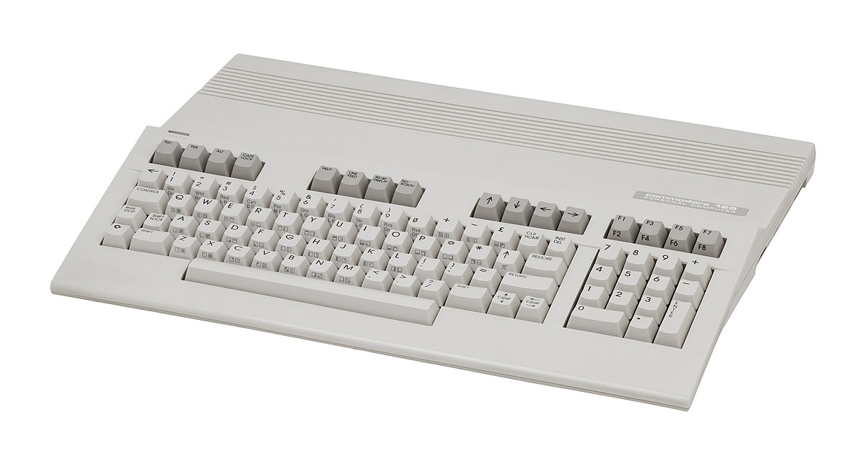
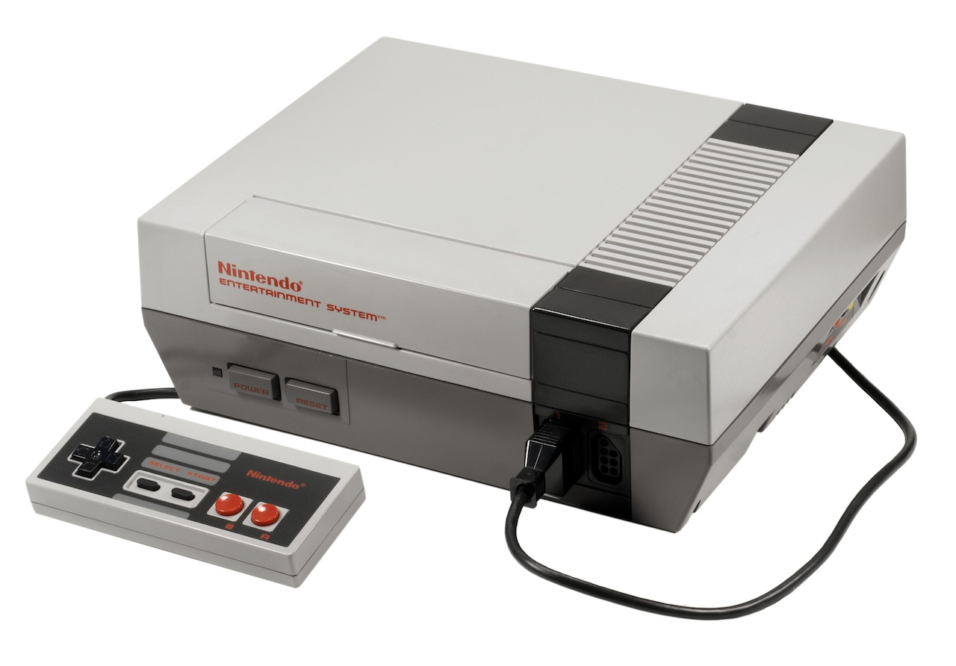
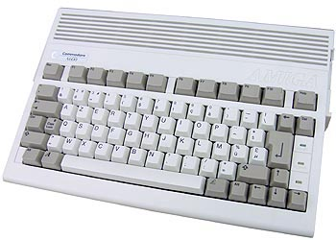
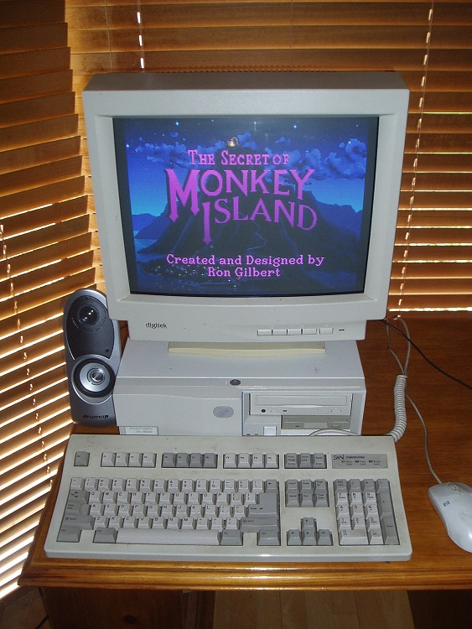
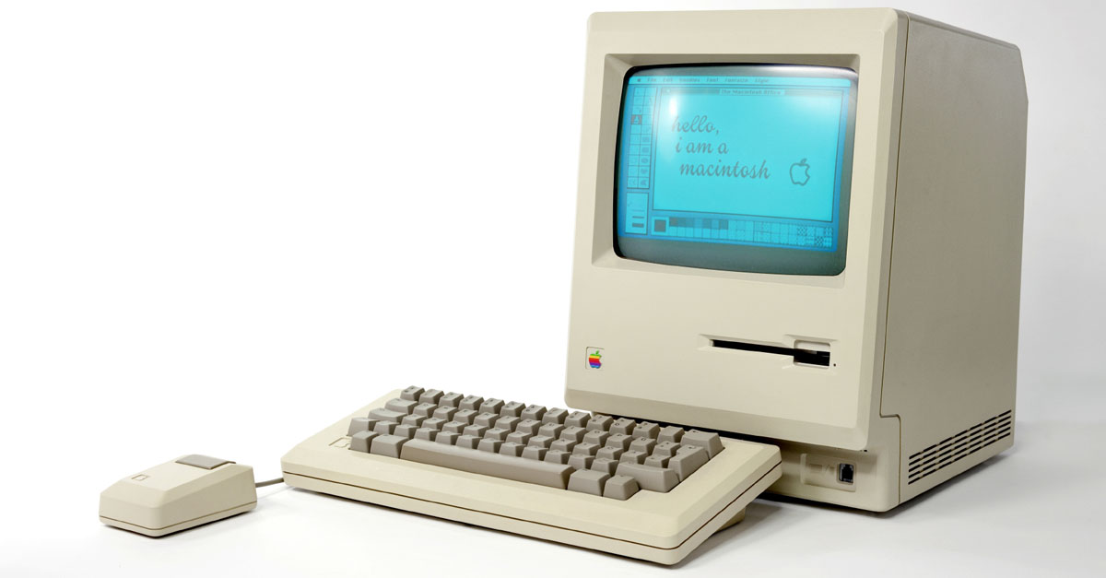
Pre-university era
Exposed to computing via C64/128 and NES (~1986)
Grown ups left us alone, they had no experience
Amiga (~1992)
Entered my first program in Easy AMOS
Apple
Basic
PC – 486DX 33Mhz (~1995)
Pascal
C++

Slide 6
Education and Professional experience
M.Sc. in Computer Science 2004
M.Sc. In Computer Engineering 2005 (Civilingenjör)
Software engineer at ABB 2006-2009
System 800xA, DCS
Lived and worked in Japan for 6 months
Software engineer at Packsize 2009-2014
Machine manufacturer for packaging machines
Senior Software engineer at ABB 2014-current
Services around System 800xA such as Mobile applications
ARRAY Industrial PhD Student 2019-current

Slide 7
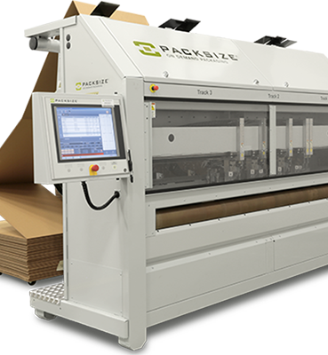

Slide 8
My road to functional programming
Took a course in Haskell in the early 200X
Then.. Nothing
In 2011-2012 I felt a “peak” with C#
The same problems surfaced over and over..
Started to look around for other languages
Tried several languages (Python, Scala, F#, etc.)
Found Clojure
Clojure (FP it turns out) addressed many of the problems I had observed in industry
Distributed stateful objects with uncontrolled mutations
Today, not using FP is painful..
(Notice how many FP features have been added to C#/Java)
Just in the last month C# 9 added an immutable record type

Slide 9
Many of the early programming language trade offs are not true any longer
Immutability have a cost
If all you have is 4096KB of memory, then update-in-place might be the only choice
Many languages are based on premises true in the 1960-1970
Memory was small and expensive
Disk was small and expensive
CPUs were single threaded
Today, developers are more expensive than hardware
If it takes me 2x longer to write code that express 10x more it is a win
A common case in Clojure (FP) is a 10x reduction in LOC compared to a Java solution

Slide 10
Simple Made Easy – Rich Hickey
Highly influential talk for me on my road to FP
Mentions many of the pains I had experienced as a practitioner in industry.
https://www.infoq.com/presentations/Simple-Made-Easy-QCon-London-2012/

Slide 11
A common industry attitude
“ Functional programing is nice for toy problems, but you can’t make real things with it”

Slide 12
Why Functional Programming Matters
https://www.youtube.com/watch?v=IyR04U66z7E

Slide 13
Why Functional Programming Matters
https://www.youtube.com/watch?v=IyR04U66z7E

Slide 14
How functional programming was (is?) taught at university
Mathy type of exercises
No projects of building ”real” things
So, the impression that FP is for academic exercises persists
Out of 5 years in CS education at the university I did 5p (7,5p) FP out of 200p (300p)
Hard for students to see the value with such low exposure
“You build real things with real languages like C/C++/C#/Java”

Slide 15
Start building “real stuff”
CRUD Web Application
UI front end
Compiler
Etc.

Slide 16
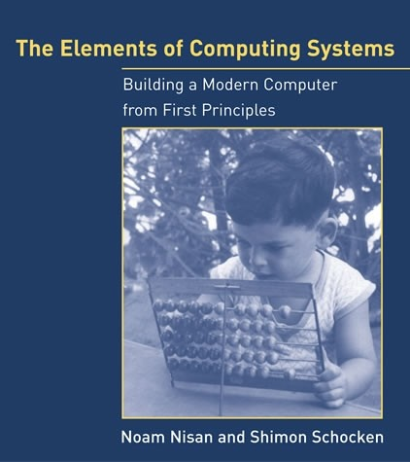
I practiced Clojure by doing this

Slide 17
Some high-profile industry users

Slide 18
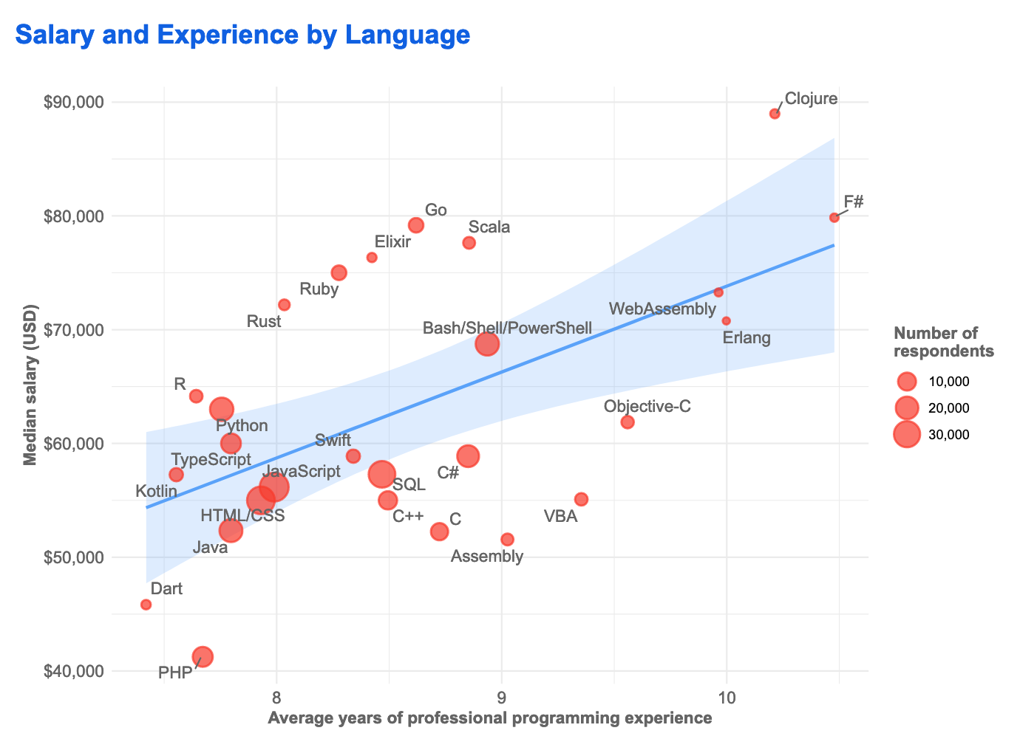
Stackoverflow survey 2019

Slide 19
My theory of why experienced programmers are drawn to FP

Slide 20
Mutable State
It will make any non-trivial application harder to reason about
Generations of programmers’ effort wasted..
The basis of logic depends on things not changing
Debugging concurrent systems with mutable state is extremely hard
In my experience, it do not scale!
Immutability and data driven pure functions do

Slide 21
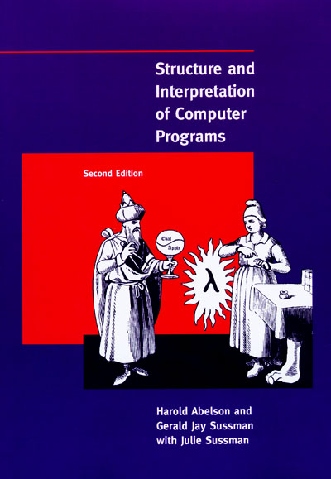
SICP - ”The wizard book”
Uses Scheme
”If programming was a religion, this would be the holy book” - Stefan Karlsson
https://mitpress.mit.edu/sites/default/files/sicp/full-text/book/book.html

Slide 22
WHY DIDN’T ANYONE TELL ME!
Basis for logic!

Slide 23
Again..

Slide 24
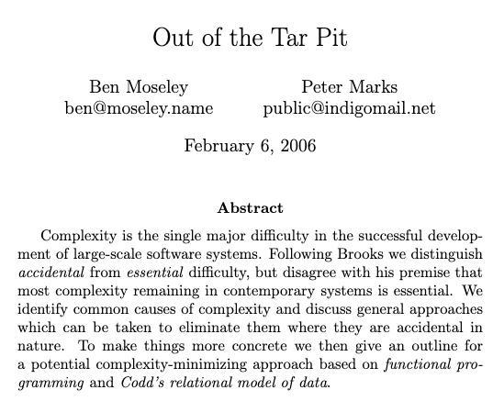

Slide 25
Rich Hickey fan club
https://github.com/tallesl/Rich-Hickey-fanclub

Slide 26
State again..
Global variables taught as bad
But Fields in OO are ok for some reason..
What's the difference?
Guard your state with warning signs
Make it explicit!
Transactions for all state not just DB!
FP solves this with immutability by default

Slide 27
But we need some state to make interesting programs
There are immutable databases!
Datomic

Slide 28
User interface – great gateway to FP
The power of immutability, a ClojureScript wrapper around React was faster than React!

Slide 29
Functional UI
M’ = F(M, A)
New Model (M’)
UI (Render M’)
Business Logic (F, M)
User Action (A)
The UI renders the new model which is produced by applying the business logic function with the current model state and user action as input

Slide 30
Functional core, imperative shell
Keep state at the edge
Use the same FP principles on all levels of the system
Simplifies every aspect of development
State
Pure functional core
DB
DB
WS
WS
Data is transacted
Everything is data
State is distributed everywhere

Slide 31
Real reuse is the function not the object
”I think the lack of reusability comes in object-oriented languages, not functional languages. Because the problem with object-oriented languages is they’ve got all this implicit environment that they carry around with them. You wanted a banana but what you got was a gorilla holding the banana and the entire jungle.
If you have referentially transparent code, if you have pure functions — all the data comes in its input arguments and everything goes out and leave no state behind — it’s incredibly reusable.”
- Joe Armstrong
DB
DB
WS
WS
Data is transacted
Everything is data
State is distributed everywhere

Slide 32
Joe Armstrong
“Making reliable distributed systems in the presence of software errors”
Great read
Inventor of Erlang
Functional and dynamically typed language aimed for reliability

Slide 33
The FP mutability trap
F# and Scala mutable objects “trap”
Tutorials from people with an OO mindset will just change the syntax not the principles
You get “Java in Scala”

Slide 34
A political battle not a technical one
I have built successful services with Clojure
Had to throw it away due to change in management..
Built web services with Clojure
Had to throw them away due to project management decision..
Not once have there been any technical argument against FP

Slide 35
Industry do not always realize what it needs
“If I had asked people what they wanted, they would have said faster horses.”
Henry Ford
Industry usually hire for tools/languages (entrenches non-FP languages)
”We want C#/Java programmers, because that is what we use”
Instead, principles would be of more value
“We want developers who can build high quality systems”

Slide 36
Apply FP lessons
Apply the lessons from FP even if you are forced to use other languages
Pure functions/methods can be applied in any language
Immutability can be applied in any language
But it requires much more discipline when the language do not help you (not idiomatic)

Slide 37
Another way in
Tooling is a way to show the benefits of FP
Do not affect production
Tests
Property-based testing is strong in FP languages (you can use this in other courses!)
Check out QuickCheck (FSCheck in F#)
John Hughes et al. (google scholar)
My paper : “QuickREST: Property-based Test Generation of OpenAPI-Described RESTful APIs”
Property-based testing in a functional language on real systems
https://arxiv.org/abs/1912.09686

Slide 38
Leverage the runtime already adopted
F# runs on the CLR
Clojure runs on the JVM/CLR/js
Libraries can be reused
The organization do not need to support another runtime

Slide 39
Learn it good and find allies
You need to be able to answer ANY FP question
“What about this? What about that?”
Try and find a coworker that is a learner
I have been asked a 1000 times about the memory cost of immutability..

Slide 40
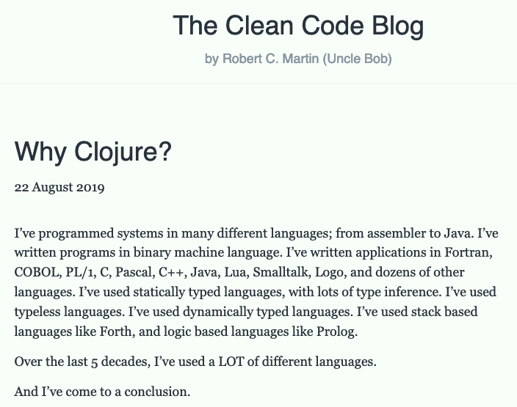

Slide 41
Be a champion of FP
"First they ignore you, then they laugh at you, then they fight you, then you win”
- Gandhi

Slide 42
Clojure
Clojure, invented by Rich Hickey in 2007
Since you know F# it might be interesting to compare with Clojure
Dynamically typed, immutable, data driven LISP
I choose Clojure based on rationality and experience not “Pop-culture”
https://clojure.org/
https://blog.cleancoder.com/uncle-bob/2019/08/22/WhyClojure.html

Slide 43
Functional Core – Imperative Edge – Never stop learning
The rest is details
@zteefo
stefan.l.karlsson@mdh.se
https://quality-developer.com/
https://github.com/zclj

