Slide 1
Functional programming in the ”real” world
Stefan Karlsson

Slide 2
Agenda
What is the image of FP in industry, in my experience
Why FP is relevant for industry, in my experience
      Strategies and learnings from promoting FP in industry
      Ask my anything

Slide 3
Goal
To assure you that FP is of high importance
To inspire you to become a champion for FP – we need you!
Providing some learning resources

Slide 4
Audience
What is your experience?
220x15x8 = 26400h (excluding my spare time coding)
Interrupt with questions if anything is unclear!

Slide 5
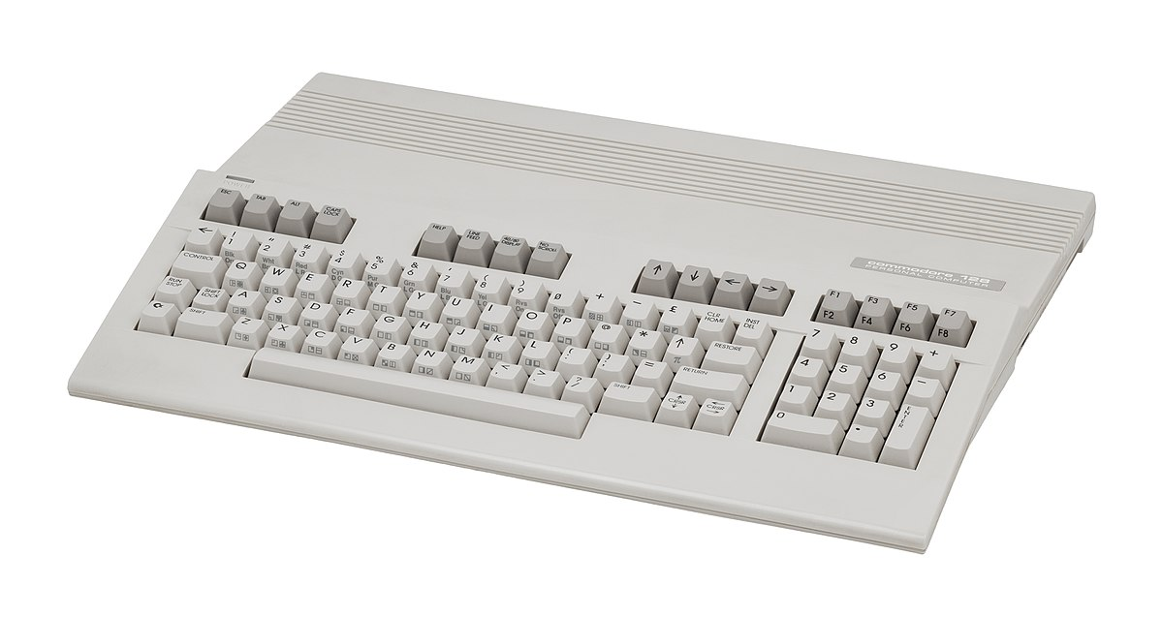

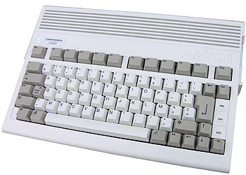
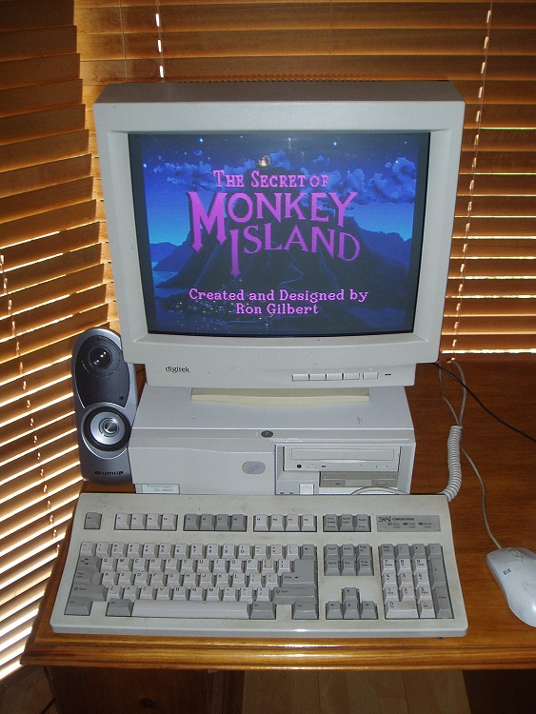
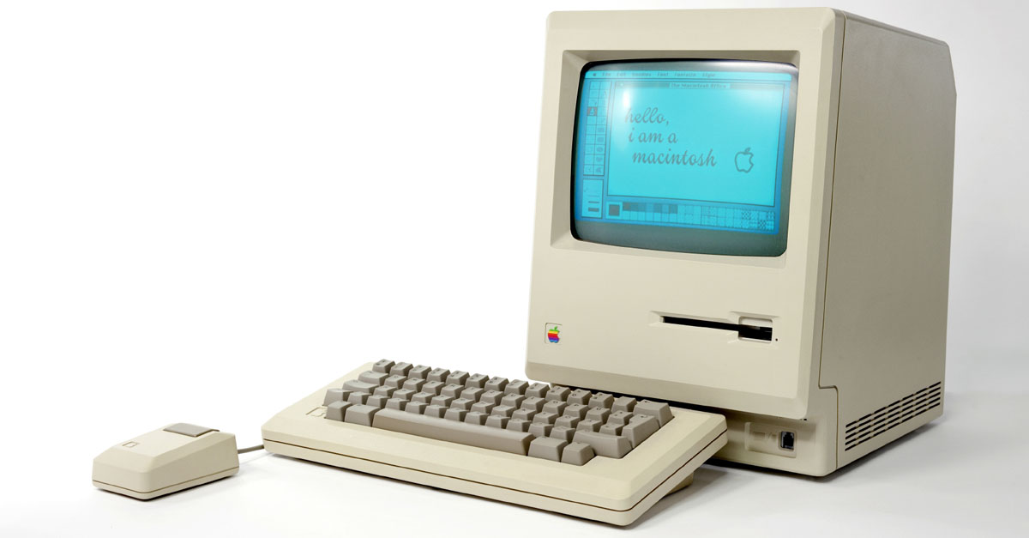
Pre-university era
Exposed to computing via C64/128 and NES (~1986)
  Grown ups left us alone, they had no experience
Amiga (~1992)
  Entered my first program in Easy AMOS
Apple
  Basic
PC – 486DX 33Mhz (~1995)
  Pascal
  C++

Slide 6



Education and Professional experience
M.Sc. in Computer Science 2004
M.Sc. In Computer Engineering 2005 (Civilingenjör)
Software engineer at ABB 2006-2009
  System 800xA, DCS
  Lived and worked in Japan for 6 months
Software engineer at Packsize 2009-2014
  Machine manufacturer for packaging machines
Senior Software engineer at ABB 2014-current
  Services around System 800xA such as Mobile applications
ARRAY Industrial PhD Student 2019-current

Slide 7




Slide 8
My road to functional programming
Took a course in Haskell in the early 200X
Then.. Nothing
In 2011-2012 I felt a “peak” with C#
  The same problems surfaced over and over..
Started to look around for other languages
Tried several languages (Python, Scala, F#, etc.)
Found Clojure
Clojure (FP it turns out) addressed many of the problems I had observed in industry
  Distributed stateful objects with uncontrolled mutations
Today, not using FP is painful..
(Notice how many FP features have been added to C#/Java)
  Just recently C# 9 added an immutable record type

Slide 9
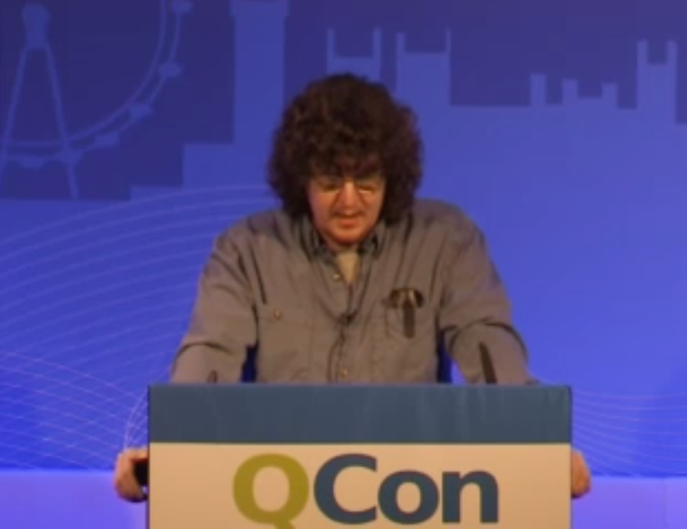
Simple Made Easy – Rich Hickey
Highly influential talk for me on my road to FP
  Mentions many of the pains I had experienced as a practitioner in industry.
https://www.infoq.com/presentations/Simple-Made-Easy-QCon-London-2012/

Slide 10
How functional programming was (is?) taught at university
“Mathy” type of exercises
No projects of building ”real” things – like in other courses
So, the impression that FP is for academic exercises persists
Out of 5 years in CS education at the university I did 5p (7,5p) FP out of 200p (300p)
  Impossible task for a teacher in FP
  Hard for students to see the value with such low exposure
  It is hard to show the benefits if you have not experienced the problems
“You build real things with real languages like C/C++/C#/Java”

Slide 11
Start building “real stuff” – More courses should use FP languages!
CRUD Web Application
UI front end
Compiler
The typical “Student-Classes” systems
Etc.

Slide 12
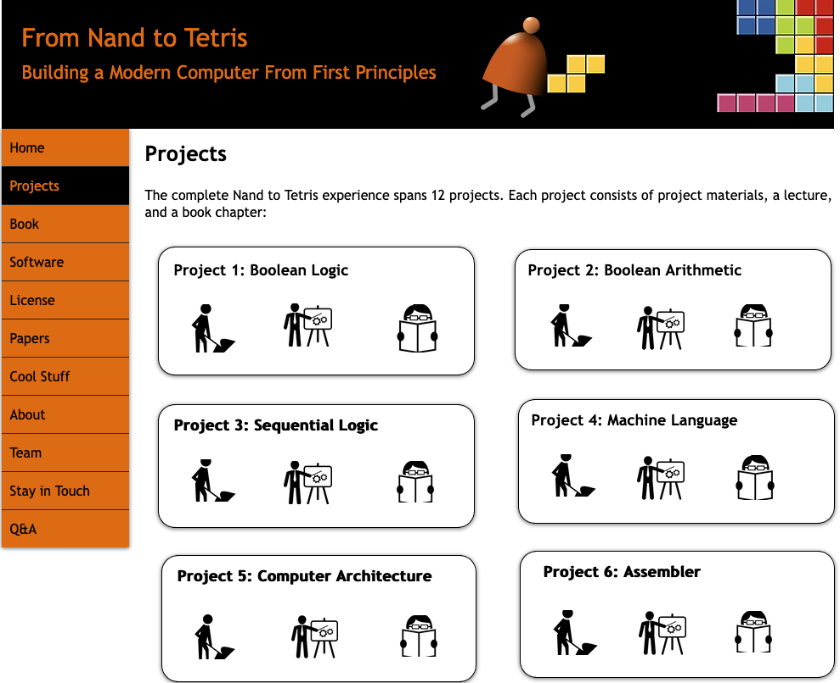
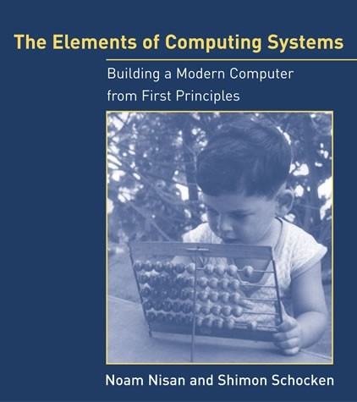

I practiced Clojure and Haskell by doing this

Slide 13
A common industry attitude
“ Functional programing is nice for toy problems, but you can’t make real things with it”

Slide 14
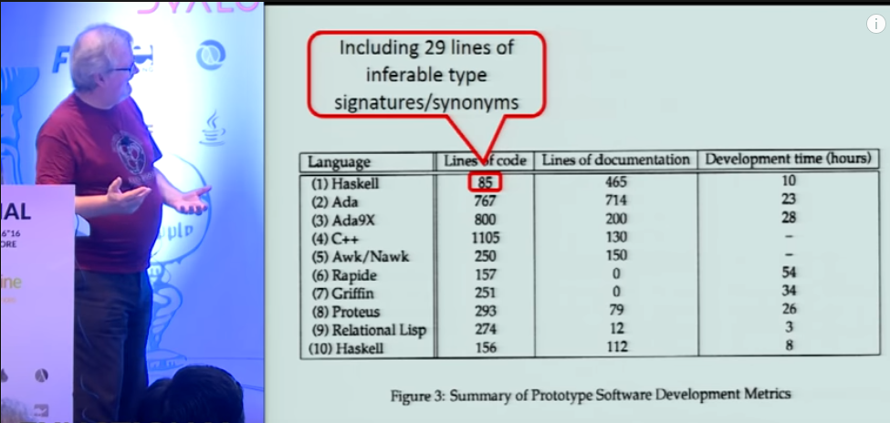
Why Functional Programming Matters
https://www.youtube.com/watch?v=IyR04U66z7E

Slide 15
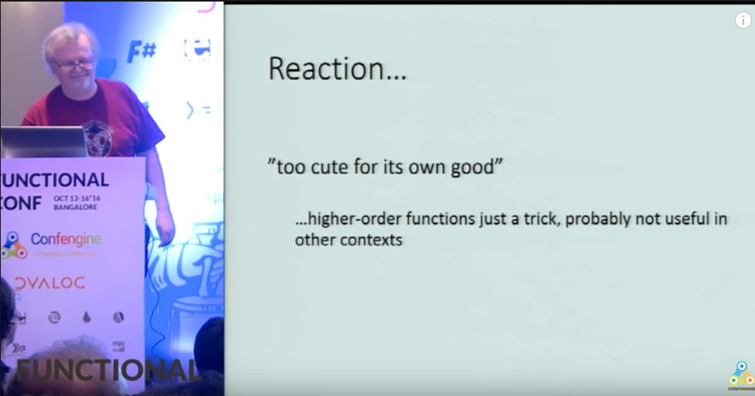
Why Functional Programming Matters
https://www.youtube.com/watch?v=IyR04U66z7E

Slide 16
Many of the early programming language trade offs are not true any longer
Immutability have a cost
If all you have is 4096KB of memory, then update-in-place might be the only choice
Many languages are based on premises true in the 1960-1970
  Memory was small and expensive
  Disk was small and expensive
  CPUs were single threaded
Today, developers are more expensive than hardware
  If it takes me 2x longer to write code that express 10x more, it is a win
  A common case in FP is a 10x reduction in LOC compared to imperative solutions

Slide 17
If FP is so great, why don’t everyone use it?
Inertia in Industry
  Change takes a long long time
  Many applications live for a long time
  Developers feel most comfortable with what they already know
  Lack of knowledge – you can help here!
But the usage is probably larger than you think

Slide 18









Some high-profile industry users

Slide 19
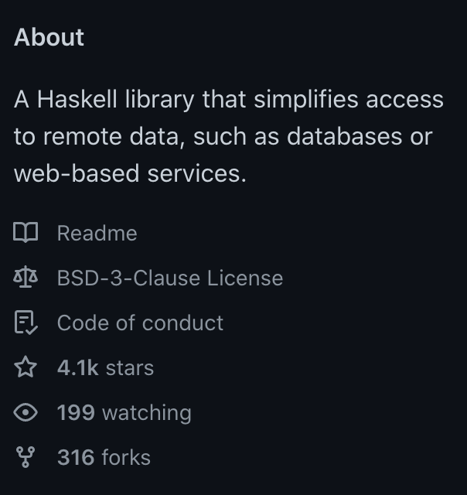
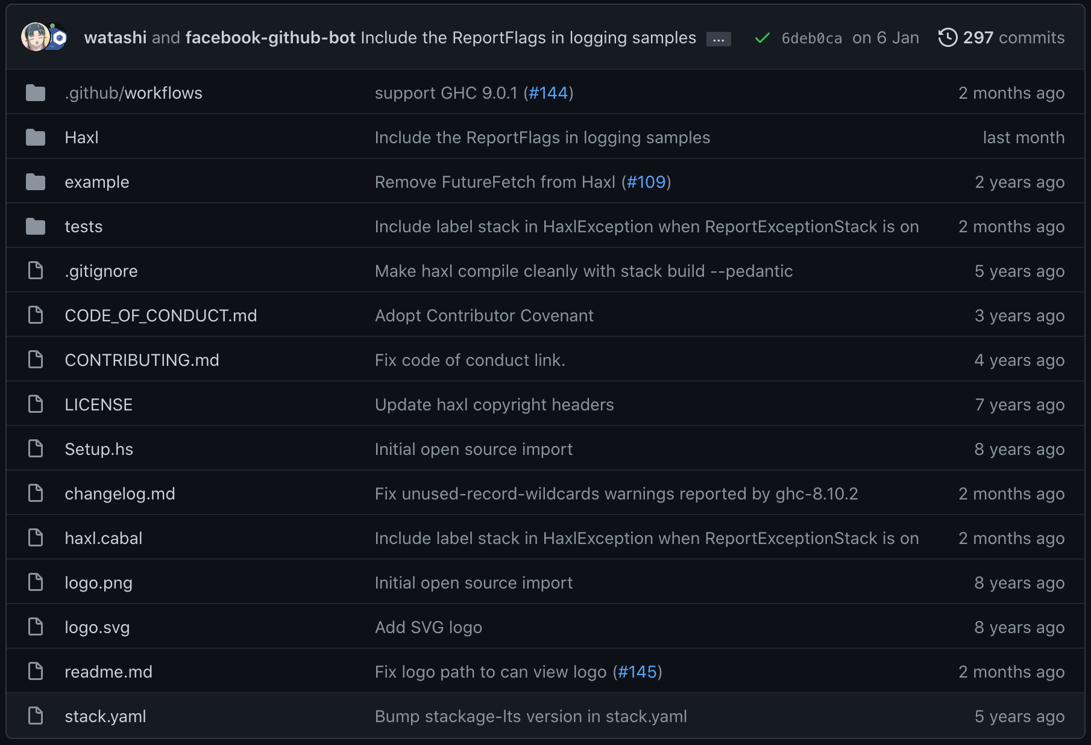
For example, Haxl from FB (https://github.com/facebook/Haxl)

Slide 20
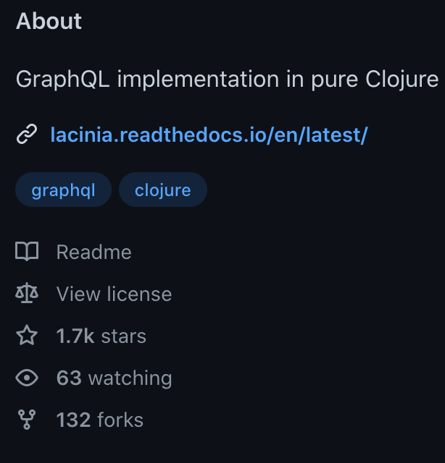
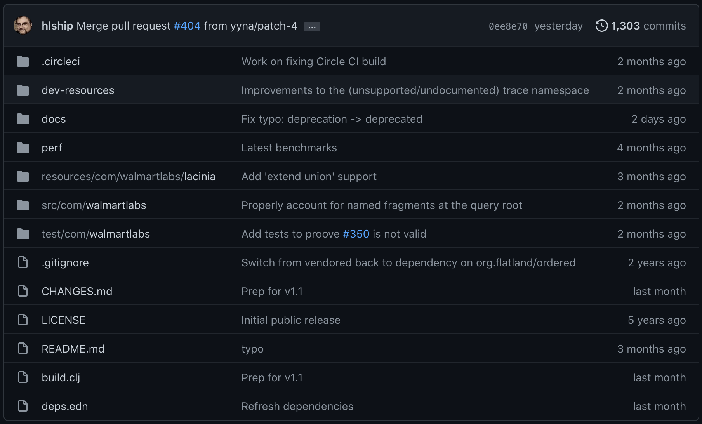
Lacinia from Walmart (https://github.com/walmartlabs/lacinia)

Slide 21
Clojure @ ABB - Converting a C# production service to Clojure
Experiment to see the benefits of moving to a functional programming language
Lines of code (LoC) is a proxy for more complicated complexity measures
  Reducing LoC is a win; less complexity, less code to maintain, test and debug.
LoC was reduced by ~70% with SAME customer facing functionality
Greatly increase code coverage (33% -> 85%) with 50% less lines of test code
  Pure functions are significantly easier to test
Property-based Testing (PBT) is easier to apply to functional code
  PBT found gaps in requirements
  PBT generated tests finding new bugs
  PBT generate many more permutations of inputs than previously tested

Slide 22
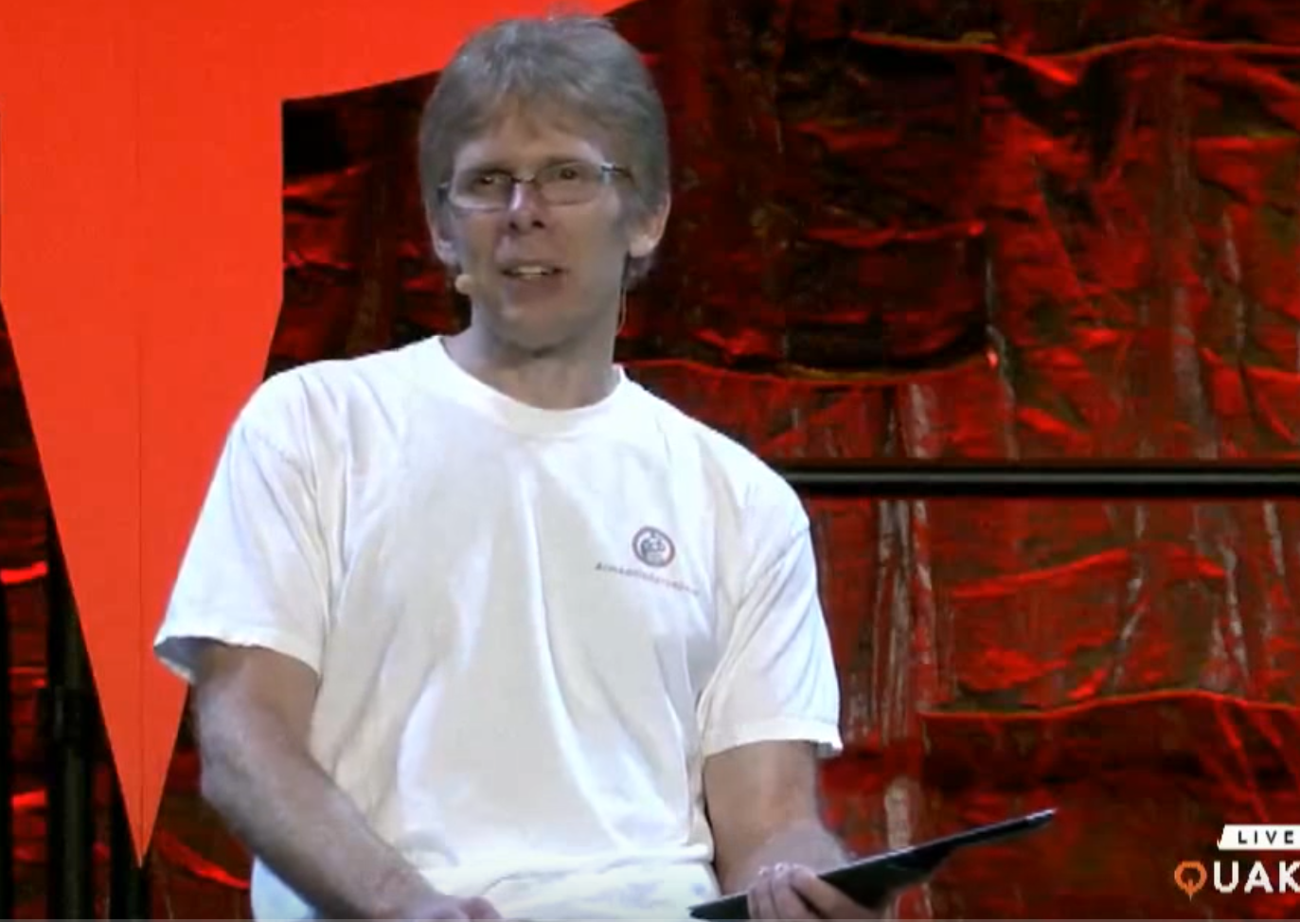
More thoughts from industry - John Carmack’s keynote at Quakecon 2013
The legendary game programmer promoting coding in a functional style
On pure functions; "I am more convinced than every that it really is a big win”
Touching on both Lisp (Scheme) and Haskell
"Strong static typing has really significant benefits”
He can not use FP languages, but can use the principles
- Starting 2:10s at : https://www.youtube.com/watch?v=1PhArSujR_A

Slide 23
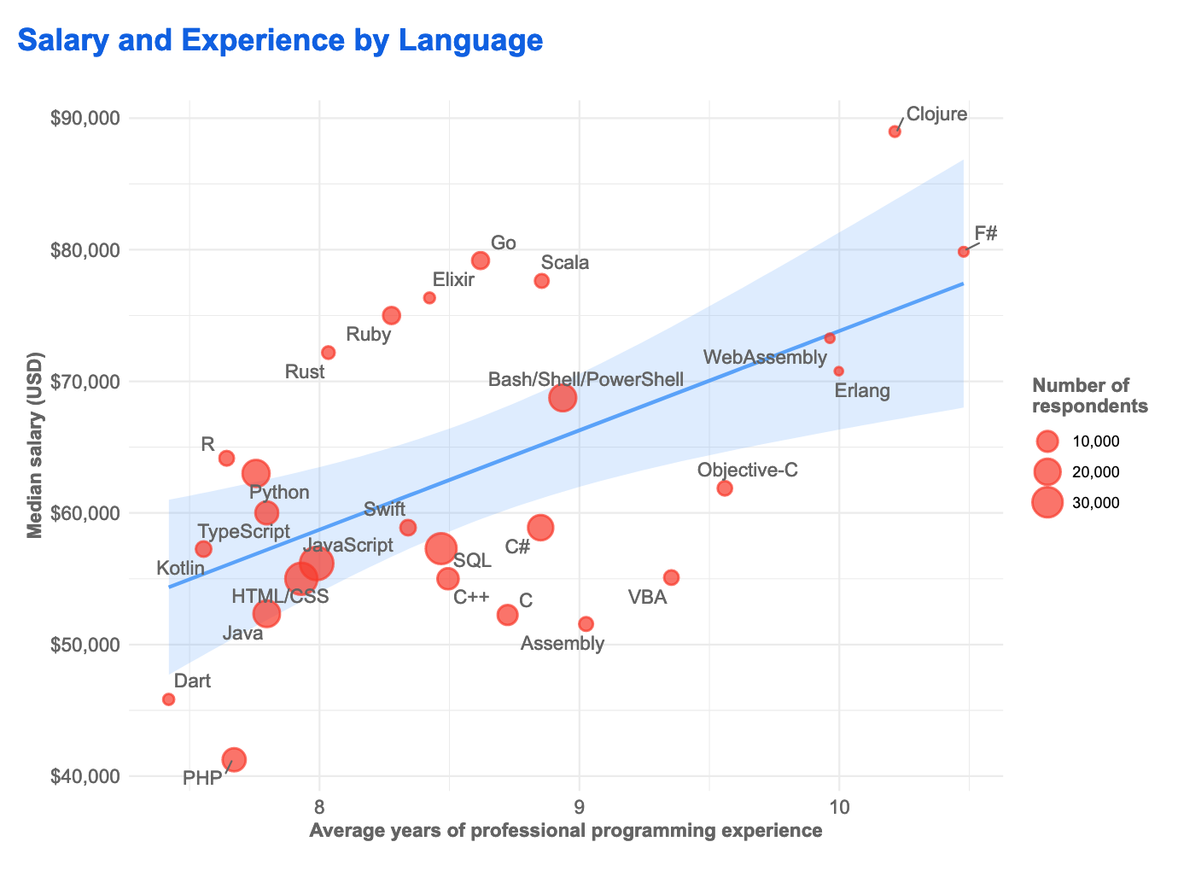


Stackoverflow survey 2019

Slide 24

My theory of why experienced programmers are drawn to FP

Slide 25
Mutable State
It will make any non-trivial application harder to reason about
  Generations of programmers’ effort wasted..
The basis of logic depends on things not changing
  Debugging concurrent systems with mutable state is extremely hard
In my experience, it do not scale!
  Immutability and data driven pure functions do

Slide 26
Is the dangers of mutable state a well guarded secret?

Slide 27
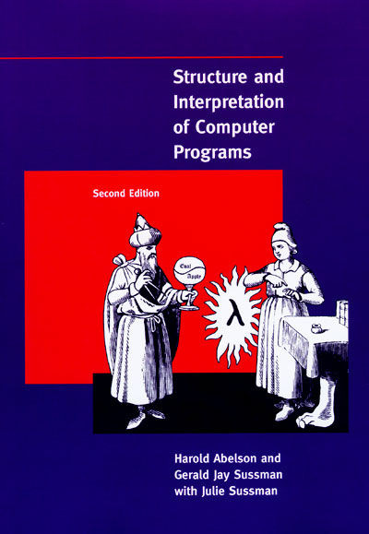
SICP - ”The wizard book”
Uses Scheme
https://mitpress.mit.edu/sites/default/files/sicp/full-text/book/book.html

Slide 28
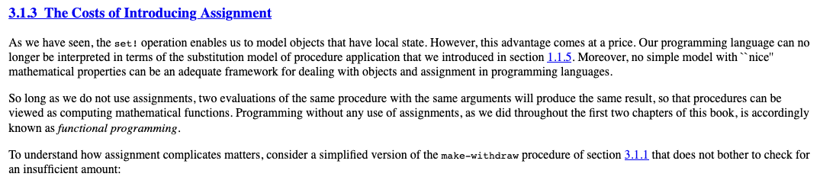

WHY DIDN’T ANYONE TELL ME!
Basis for logic!

Slide 29
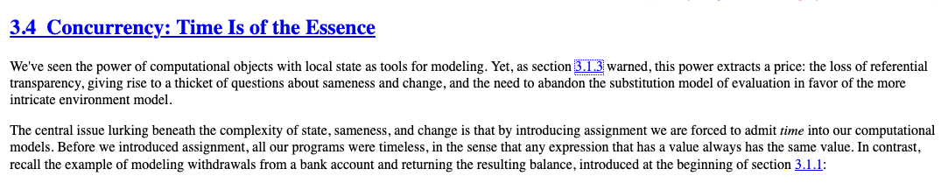
Again..

Slide 30
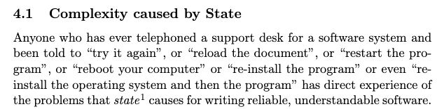
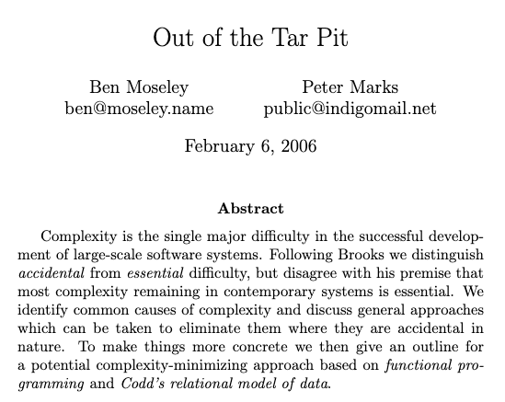
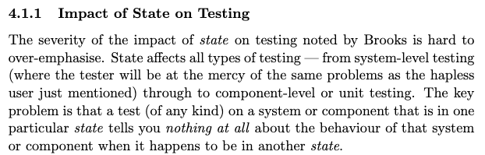

Slide 31

Rich Hickey fan club – collection of interesting talks on this topic
https://github.com/tallesl/Rich-Hickey-fanclub

Slide 32


State again..
Global variables taught as bad
  But mutable fields in OO are ok for some reason..
  What's the difference?
Guard your state with warning signs
  Make it explicit!
  Transactions for all state not just DB!
  FP solves this with immutability by default
    Monads, STM, Atoms, etc

Slide 33
The FP mutability trap
F# and Scala mutable objects “trap”
Tutorials from people with an OO mindset will just change the syntax not the principles
  You get “Java in Scala”
Haskell will make it harder to not do proper FP

Slide 34



But we need some state to make interesting programs
There are immutable databases! This means you can go back in time!
Datomic
https://github.com/xtdb/xtdb

Slide 35
Functional core, imperative shell
Keep state at the edge
Use the same FP principles on all levels of the system
Simplifies every aspect of development
State
Pure functional core
C
DB
B
DB
A
B
C
WS
A
WS
Data is transacted
Everything is data
State is distributed everywhere
https://www.destroyallsoftware.com/screencasts/catalog/functional-core-imperative-shell

Slide 36
Real reuse is the function not the object
”I think the lack of reusability comes in object-oriented languages, not functional languages. Because the problem with object-oriented languages is they’ve got all this implicit environment that they carry around with them. You wanted a banana but what you got was a gorilla holding the banana and the entire jungle.
If you have referentially transparent code, if you have pure functions — all the data comes in its input arguments, and everything goes out and leave no state behind — it’s incredibly reusable.”
- Joe Armstrong
DB
DB
WS
WS
Data is transacted
Everything is data
State is distributed everywhere

Slide 37
Joe Armstrong
“Making reliable distributed systems in the presence of software errors”
  Great read
Inventor of Erlang
  Functional and dynamically typed language aimed for reliability

Slide 38


User interfaces – move to functional core
The power of immutability, a ClojureScript wrapper around React was faster than React!

Slide 39
Functional UI
M’ = F(M, A)
New Model (M’)
UI (Render M’)
Business Logic (F, M)
User Action (A)
The UI renders the new model which is produced by applying the business logic function with the current model state and user action as input

Slide 40
A political battle not a technical one
I have built successful services with Clojure
  Had to throw it away due to change in management..
Built web services with Clojure
  Had to throw them away due to project management decision..
Not once have there been any technical argument against FP

Slide 41
Industry do not always realize what it needs
“If I had asked people what they wanted, they would have said faster horses.”
Henry Ford
Industry usually hire for tools/languages (entrenches non-FP languages)
  ”We want C#/Java programmers, because that is what we use”
Instead, principles would be of more value
  “We want developers who can build high quality systems”

Slide 42
Apply FP lessons
Apply the lessons from FP even if you are forced to use other languages
  Pure functions/methods can be applied in any language
  Immutability can be applied in any language
  But it requires much more discipline when the language do not help you (not idiomatic)

Slide 43
Another way in
Tooling is a way to show the benefits of FP
  Do not affect production
Tests
  Property-based testing is strong in FP languages (you can use this in other courses!)
  Check out QuickCheck (FSCheck in F#)
  John Hughes et al. (google scholar)
  My paper : “QuickREST: Property-based Test Generation of OpenAPI-Described RESTful APIs”
        Property-based testing in a functional language on real systems
        https://arxiv.org/abs/1912.09686

Slide 44
Leverage the runtime already adopted
F# runs on the CLR
Clojure runs on the JVM/CLR/js
Libraries can be reused
The organization do not need to support another runtime

Slide 45
Learn it good and find allies
You need to be able to answer ANY FP question
  “What about this? What about that?”
Try and find a coworker that is a learner
I have been asked a 1000 times about the memory cost of immutability..

Slide 46
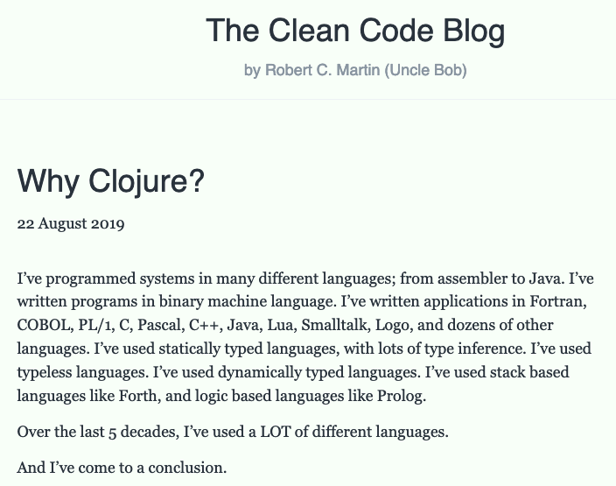

Slide 47
Be a champion of FP
"First they ignore you, then they laugh at you, then they fight you, then you win”
- Gandhi

Slide 48

Clojure
Clojure, invented by Rich Hickey in 2007
Since you know F# it might be interesting to compare with Clojure
  Dynamically typed, immutable, data driven Lisp
https://clojure.org/
https://blog.cleancoder.com/uncle-bob/2019/08/22/WhyClojure.html

Slide 49

Haskell
Haskell, created in 1990
Purely functional
Statically typed
https://www.haskell.org/

Slide 50
Functional Core – Imperative Edge – Never stop learning
The rest is details
@zteefo
stefan.l.karlsson@mdh.se
https://quality-developer.com/
https://github.com/zclj

