Slide 1
Functional programming in practice
Stefan Karlsson

Slide 2
Agenda
What is the image of FP in industry, in my experience
Why FP is relevant for industry, in my experience
      Strategies and learnings from promoting FP in industry
      Ask my anything – hopefully, you have some questions

Slide 3
Goal
To assure you that FP is of high importance
To inspire you to become a champion for FP – we need you!
Providing some learning resources

Slide 4
Please ask if anything is unclear!
Lost in experience
  What is clear to me, might not be clear to you
Interrupt with questions anytime!

Slide 5
Based on experience – We are still waiting for the facts
I can give my experience on the value of FP
As far as I know, there are no decisive studies on:
  FP vs. OOP
  Static vs. Dynamic
  Language A vs. Language B
It is very hard to do such studies, many factors to consider
  People are different
  Skill levels are different
  Problem domains are different
  Familiarity with the problem domain is different
  Etc.
I hope to convey that the FP principles are important to industry

Slide 6
My road to functional programming
Took a course in Haskell in the early 200X
Then.. Nothing
In 2011-2012 I felt a “peak” with OOP (C++/C#)
  The same problems surfaced over and over..
Started to look around for other languages
Tried several languages (Python, Scala, F#, etc.)
Found Clojure
Clojure (FP it turns out) addressed many of the problems I had observed in industry
  Distributed stateful objects with uncontrolled mutations
Today, not using FP principles is painful..
(Notice how many FP features have been added to C#/Java)
  For example, C# 9 added an immutable record type, long before that - lambdas

Slide 7
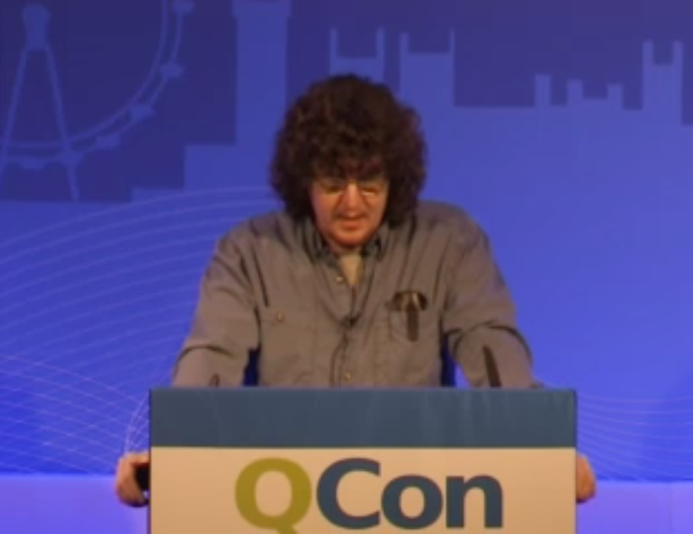
Simple Made Easy – Rich Hickey
At this time, he had 25+ years of experience – describing the problems I also had observed
Highly influential talk for me on my road to FP
  Mentions many of the pains I had experienced as a practitioner in industry.
https://www.infoq.com/presentations/Simple-Made-Easy-QCon-London-2012/
Raises the idea of an objective measure of complexity
  The amount of how intertwined things are
A
B
C
Simple
B
Complex
A
C

Slide 8
How functional programming was (is?) taught at university
“Mathy” type of exercises
No projects of building ”real” things – like in other courses
  Other courses could build on top of a known language
    compiler, OS, datacom with C
So, the impression that FP is for academic exercises persists
Out of 5 years in CS education at the university I did 5p (7,5p) FP out of 200p (300p)
  Impossible task for a teacher in FP
  Hard for students to see the value with such low exposure
  It is hard to show the benefits if you have not experienced the problems
    Complexity do not scale! (but how can you know that if you haven’t tried?)
“You build real things with real languages like C/C++/C#/Java”

Slide 9
Start building “real stuff” – More courses should use FP languages!
CRUD Web Application
UI front end
Compiler
The typical “Student-Classes” systems
Etc.

Slide 10
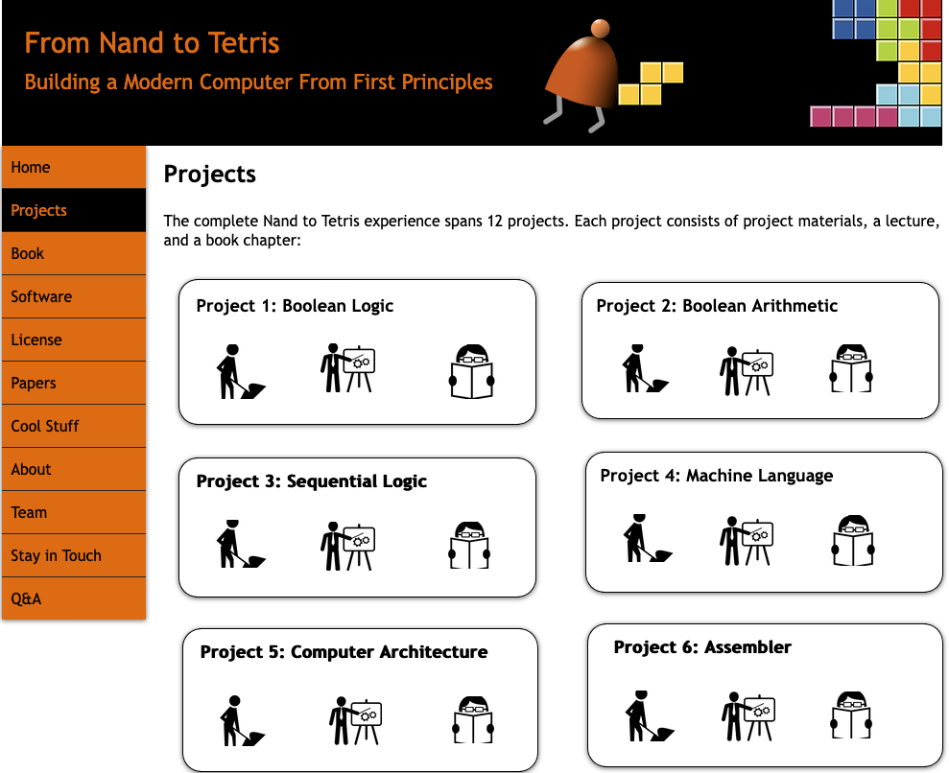
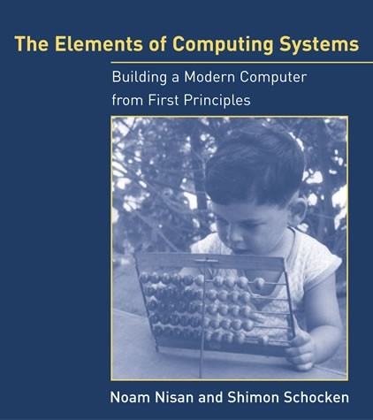

I practiced Clojure and Haskell by doing this

Slide 11
A common industry attitude
“ Functional programing is nice for toy problems, but you can’t make real things with it”
However, we are getting less and less of this!

Slide 12
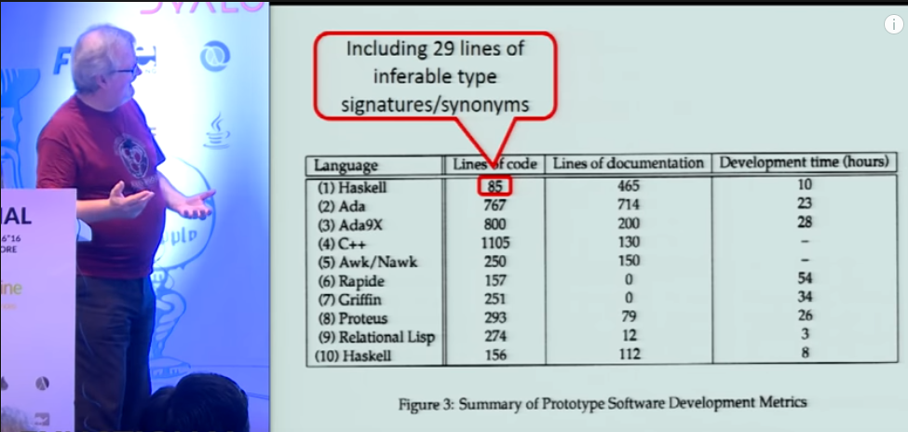
Why Functional Programming Matters
https://www.youtube.com/watch?v=IyR04U66z7E

Slide 13
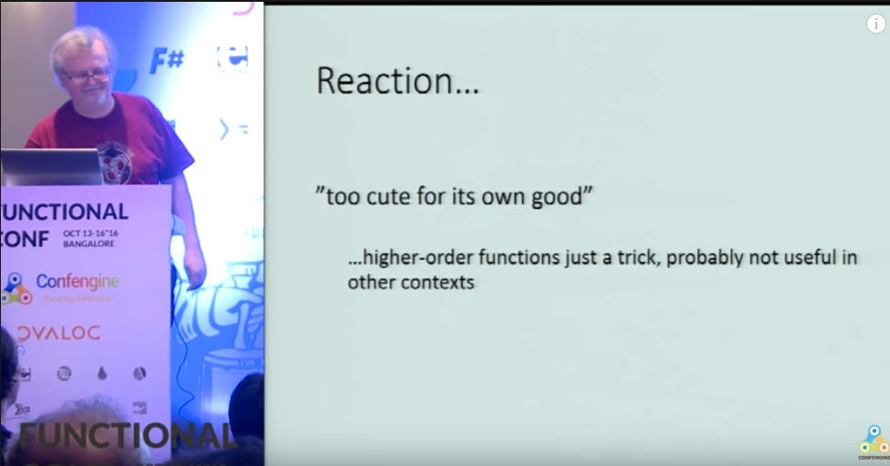
Why Functional Programming Matters
https://www.youtube.com/watch?v=IyR04U66z7E

Slide 14
Many of the early programming language trade offs are not true any longer
Immutability have a cost
If all you have is 4096KB of memory, then update-in-place might be the only choice
Many languages are based on premises true in the 1960-1970
  Memory was small and expensive
  Disk was small and expensive
  CPUs were single threaded
Today, developers are more expensive than hardware
  If it takes me 2x longer to write code that express 10x more, it is a win
  A common case in FP is a 10x reduction in LOC compared to imperative solutions
  But as good engineers we should always consider the cost/benefit of FP principles

Slide 15
If FP is so great, why don’t everyone use it?
Inertia in Industry - large investments have already been made
  Change takes a long long time
  Many applications live for a long time
  Developers feel most comfortable with what they already know
  Lack of knowledge – you can help here!
But the usage is probably larger than you think

Slide 16



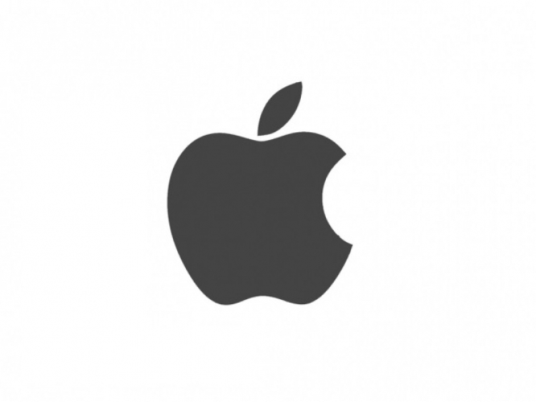






Some high-profile industry users

Slide 17
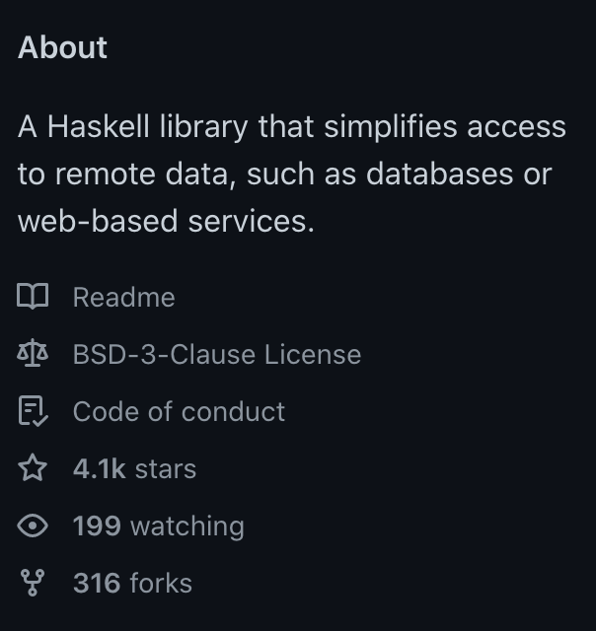
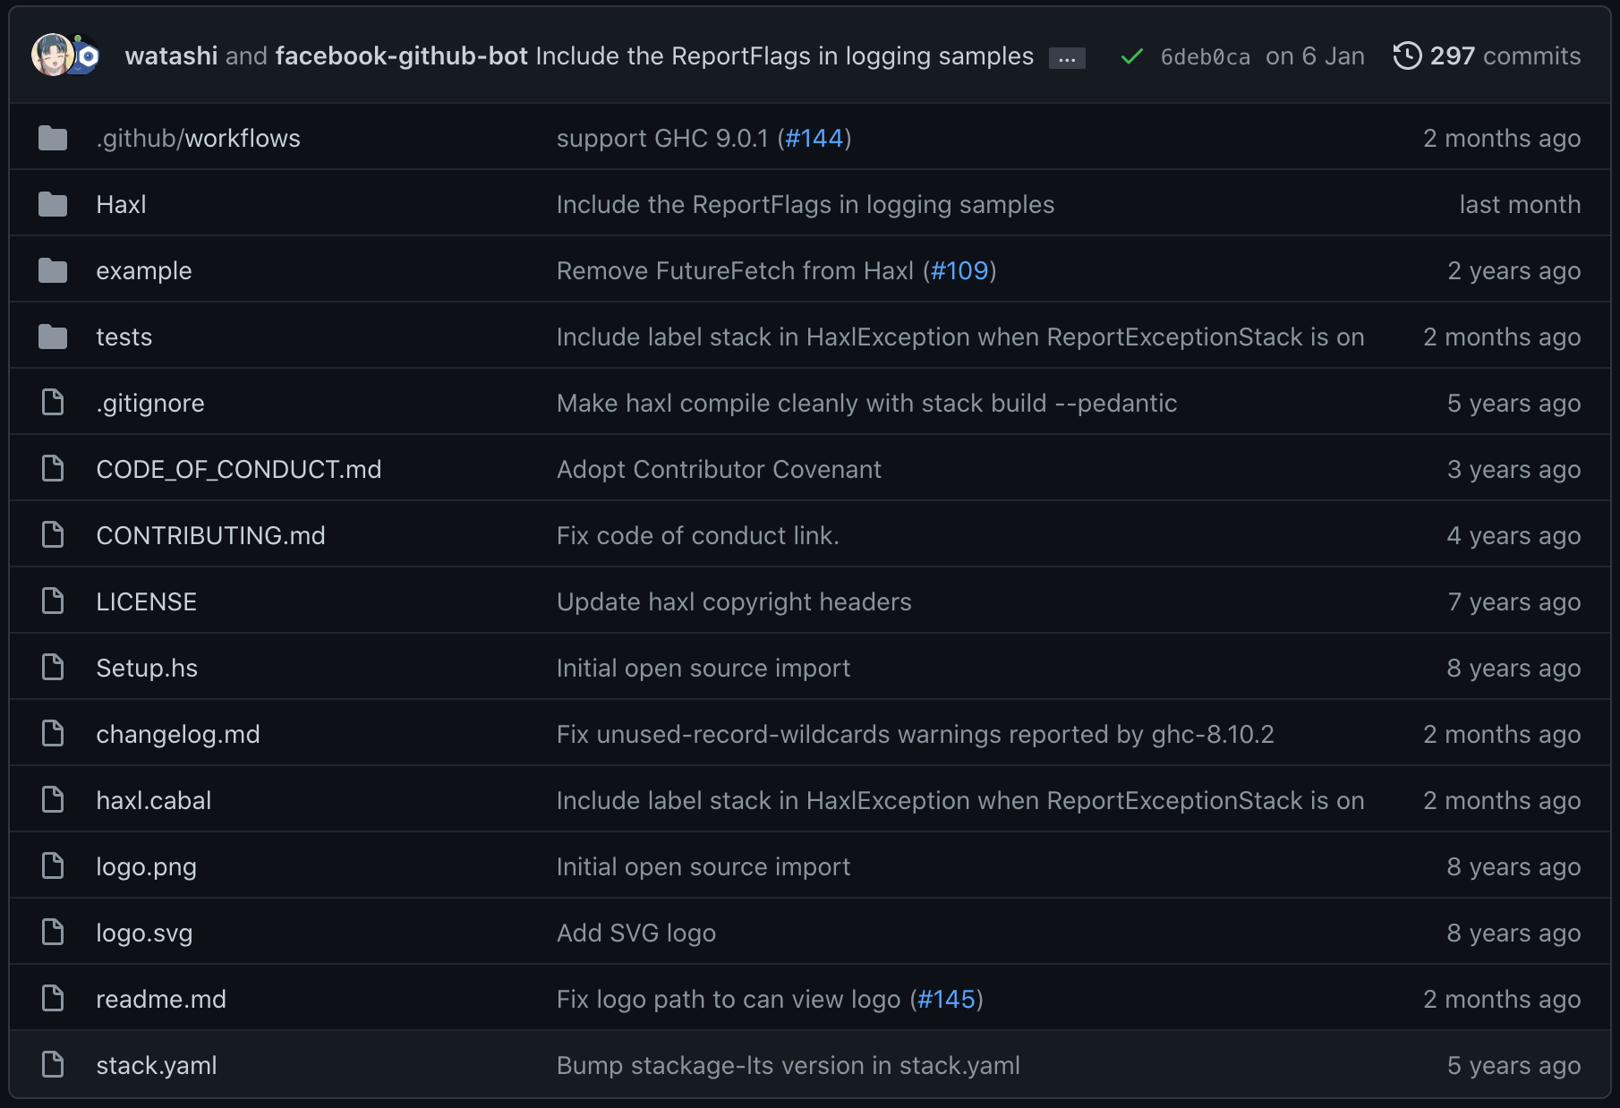
For example, Haxl from FB (https://github.com/facebook/Haxl)

Slide 18
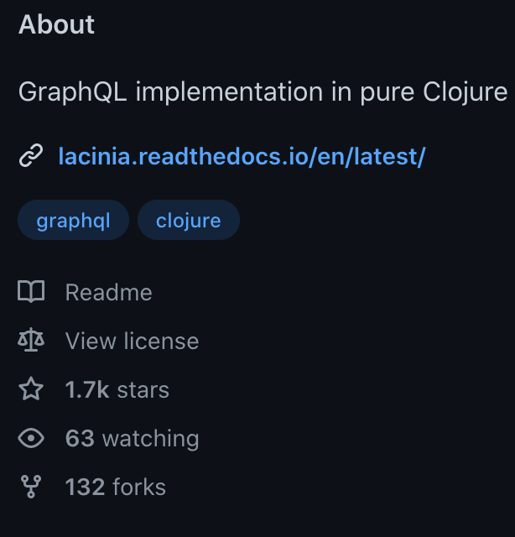
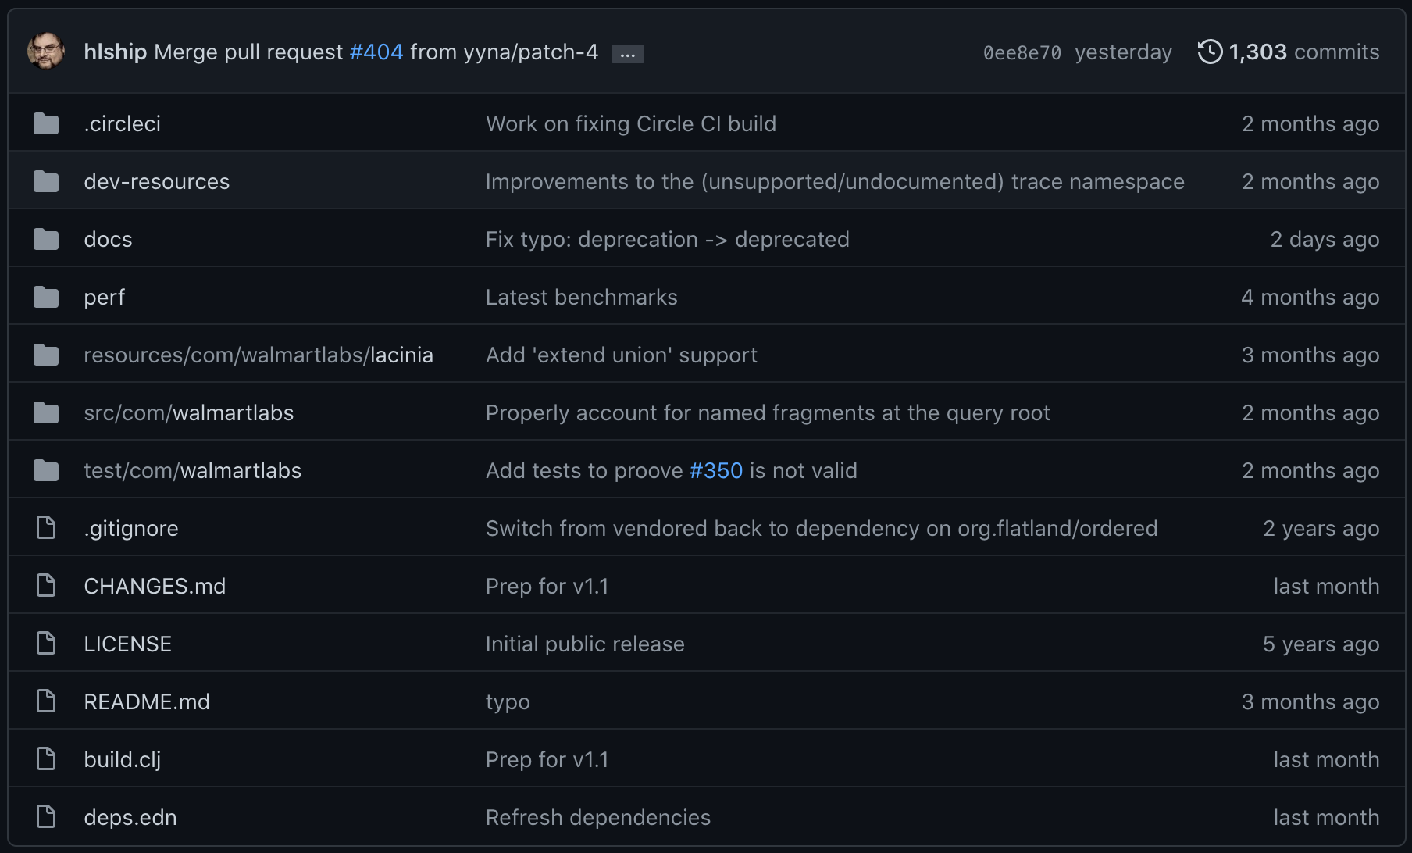
Lacinia from Walmart (https://github.com/walmartlabs/lacinia)

Slide 19
Clojure @ ABB - Converting a C# production service to Clojure
Experiment to see the benefits of moving to a functional programming language
Lines of code (LoC) is a proxy for more complicated complexity measures
  Reducing LoC is a win; less complexity, less code to maintain, test and debug.
LoC was reduced by ~70% with SAME customer facing functionality
Greatly increased code coverage (33% -> 85%) with 50% less lines of test code
  Pure functions are significantly easier to test
Property-based Testing (PBT) is easier to apply to functional code
  PBT found gaps in requirements
  PBT generated tests finding new bugs
  PBT generate many more permutations of inputs than previously tested

Slide 20
Clojure @ ABB - 2023
Team of 5 Developers
Building a new version of a product from scratch
Backend (Clojure) and frontend (ClojureScript)
Positive experience so far

Slide 21
Clojure @ ABB - 2024
Moving to Rust
  Resource usage
  Other teams don’t know Clojure
    (They don’t use Rust either, but more willing to learn)
  Rust supports several FP principles

Slide 22
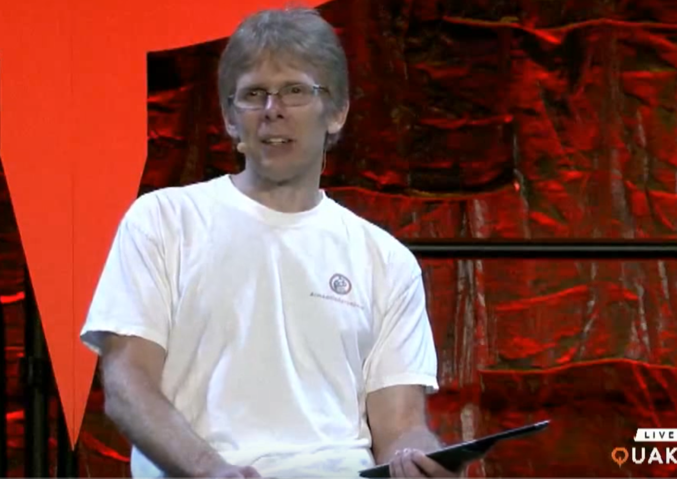
More thoughts from industry - John Carmack’s keynote at Quakecon 2013
The legendary game programmer promoting coding in a functional style
On pure functions; "I am more convinced than ever that it really is a big win”
Touching on both Lisp (Scheme) and Haskell
"Strong static typing has really significant benefits”
He can not use FP languages, but can use the principles
- Starting 2:10s at : https://www.youtube.com/watch?v=1PhArSujR_A

Slide 23
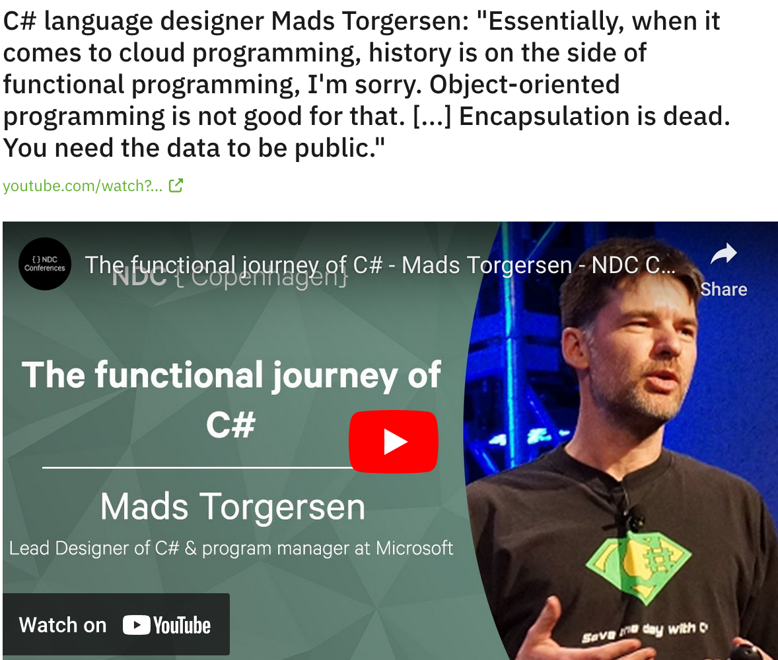
https://www.youtube.com/watch?v=CLKZ7ZgVido&t=2835s

Slide 24
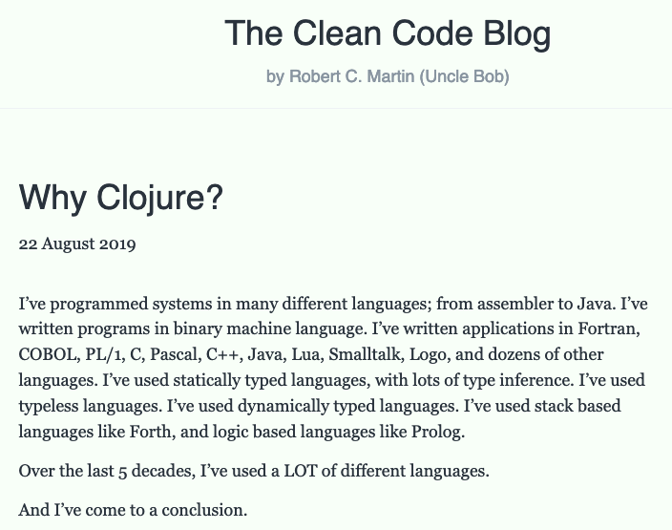

Slide 25
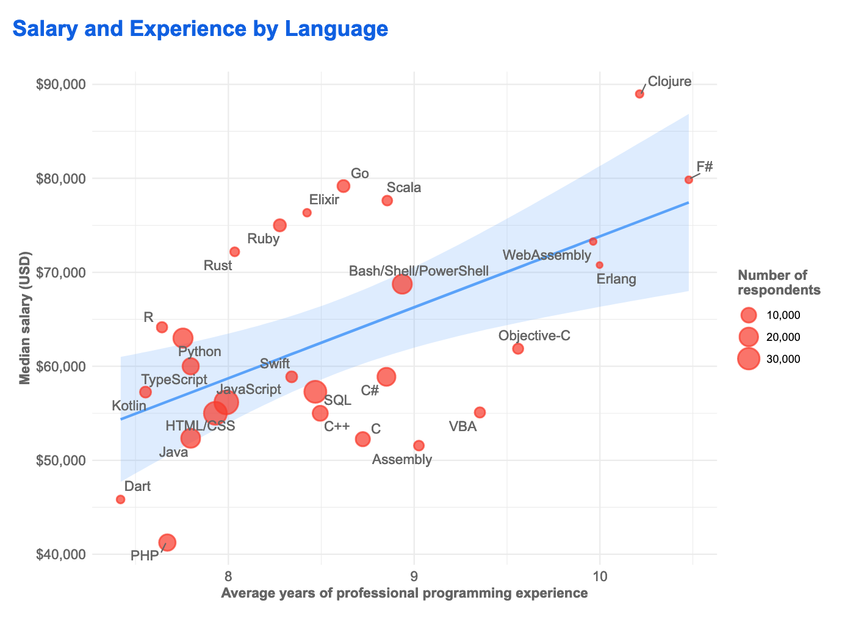


Stackoverflow survey 2019

Slide 26
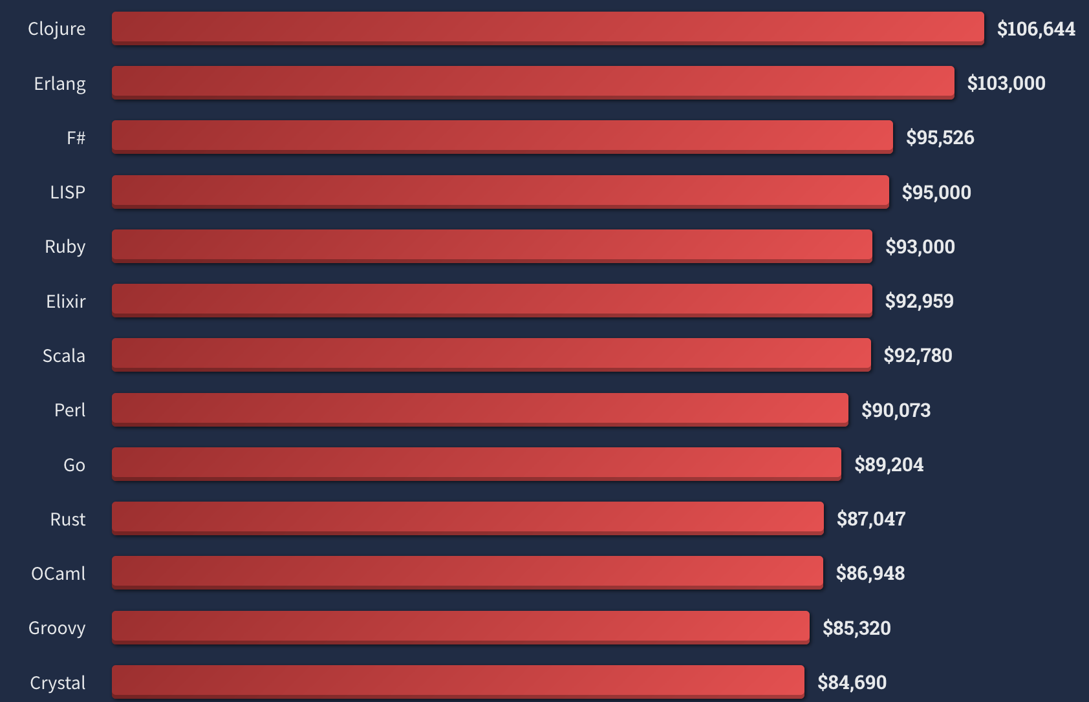
Top paying 2022
https://survey.stackoverflow.co/2022/#technology-top-paying-technologies

Slide 27
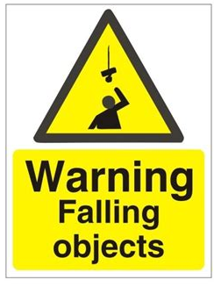
My theory of why experienced programmers are drawn to FP
They have experienced the problems of complexity

Slide 28
Mutable State
It will make any non-trivial application harder to reason about
  Generations of programmers’ effort wasted..
The basis of logic depends on things not changing
  Debugging concurrent systems with mutable state is extremely hard
In my experience, it do not scale!
  Immutability and data driven pure functions do

Slide 29
Is the dangers of mutable state a well guarded secret?

Slide 30
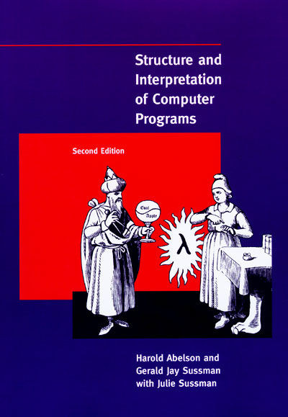
SICP - ”The wizard book”
Uses Scheme
https://mitpress.mit.edu/sites/default/files/sicp/full-text/book/book.html

Slide 31
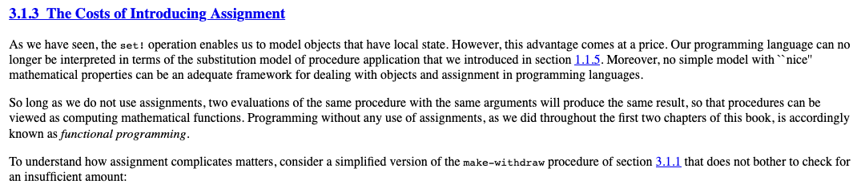

WHY DIDN’T ANYONE TELL ME!
Basis for logic!

Slide 32
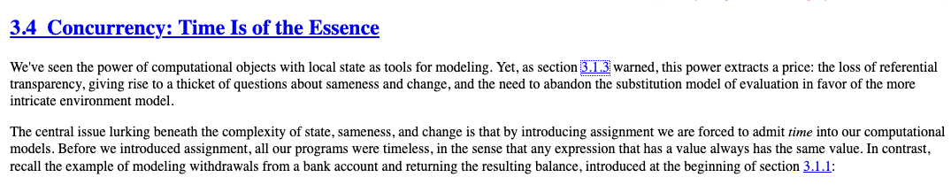
Again..

Slide 33
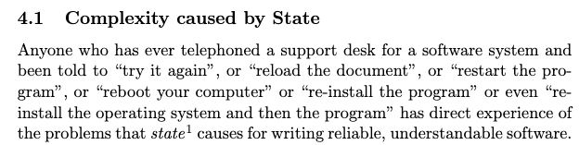
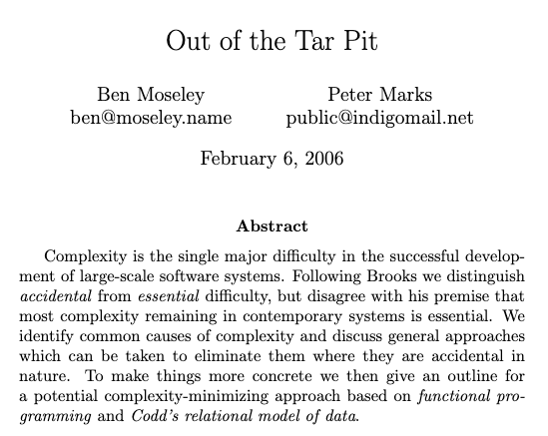
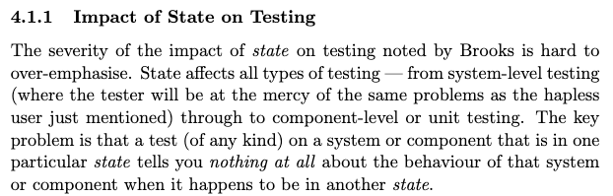

Slide 34

Rich Hickey fan club – collection of interesting talks on this topic
https://github.com/tallesl/Rich-Hickey-fanclub

Slide 35


State again..
Global variables taught as bad
  But mutable fields in OO are ok for some reason..
  What's the difference?
Guard your state with warning signs
  Make it explicit!
  Transactions for all state not just DB!
  FP solves this with immutability by default
    Monads, STM, Atoms, etc

Slide 36
The FP mutability trap
F# and Scala mutable objects “trap”
  When you interact with the host platform you get mutable objects
Tutorials from people with an OO mindset will just change the syntax not the principles
  You get “Java in Scala”
Haskell will make it harder to not do proper FP

Slide 37



But we need some state to make interesting programs
There are immutable databases! This means you can go back in time!
Datomic
https://github.com/xtdb/xtdb

Slide 38
Functional core, imperative shell
Keep state at the edge
Use the same FP principles on all levels of the system
Simplifies every aspect of development
State
Pure functional core
C
DB
B
DB
A
B
C
WS
A
D
WS
D
Data is transacted
Everything is data
State is distributed everywhere
https://www.destroyallsoftware.com/screencasts/catalog/functional-core-imperative-shell

Slide 39
Real reuse is the function not the object
”I think the lack of reusability comes in object-oriented languages, not functional languages. Because the problem with object-oriented languages is they’ve got all this implicit environment that they carry around with them. You wanted a banana but what you got was a gorilla holding the banana and the entire jungle.
If you have referentially transparent code, if you have pure functions — all the data comes in its input arguments, and everything goes out and leave no state behind — it’s incredibly reusable.”
- Joe Armstrong
DB
DB
WS
WS
Data is transacted
Everything is data
State is distributed everywhere

Slide 40
Joe Armstrong
“Making reliable distributed systems in the presence of software errors”
  Great read
Inventor of Erlang
  Functional and dynamically typed language aimed for reliability

Slide 41


Another part of real-world systems: User interfaces – move to functional core
The power of immutability, a ClojureScript wrapper around React was faster than React!

Slide 42
Functional UI
M’ = F(M, A)
New Model (M’)
UI (Render M’)
Business Logic (F, M)
User Action (A)
The UI renders the new model which is produced by applying the business logic function with the current model state and user action as input

Slide 43
A political battle not a technical one
I have built successful services with Clojure
  Had to throw it away due to change in management..
Built web services with Clojure
  Had to throw them away due to project management decision..
Not once have there been any technical argument against FP
  (it has been on the resource consumption)
Humans in general like to protect the status quo

Slide 44
Industry do not always realize what it needs
“If I had asked people what they wanted, they would have said faster horses.”
Henry Ford
Industry usually hire for tools/languages (entrenches non-FP languages)
  ”We want C#/Java programmers, because that is what we use”
Instead, principles would be of more value
  “We want developers who can build high quality systems”

Slide 45
Apply FP lessons
Apply the lessons from FP even if you are forced to use other languages
  Pure functions/methods can be applied in any language
  Immutability can be applied in any language
  But it requires much more discipline when the language do not help you (not idiomatic)
    And higher friction

Slide 46
Another way in
Tooling is a way to show the benefits of FP
  Do not affect production
Tests
  Property-based testing is strong in FP languages (you can use this in other courses!)
  Check out QuickCheck (FSCheck in F#)
  John Hughes et al. (google scholar)
  My paper : “QuickREST: Property-based Test Generation of OpenAPI-Described RESTful APIs”
        Property-based testing in a functional language on real systems
        https://arxiv.org/abs/1912.09686

Slide 47
Leverage the runtime already adopted
F# runs on the CLR
Clojure runs on the JVM/CLR/js
Libraries can be reused
The organization do not need to support another runtime

Slide 48
Learn it good and find allies
You need to be able to answer ANY FP question
  “What about this? What about that?”
  Again, people want to find a reason to keep the status quo
Try and find a coworker that is a learner
I have been asked a 1000 times about the memory cost of immutability..

Slide 49
Be a champion of FP
"First they ignore you, then they laugh at you, then they fight you, then you win”
- Gandhi

Slide 50
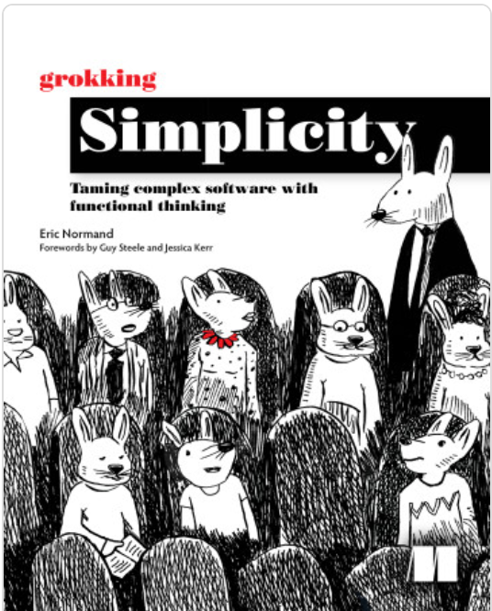
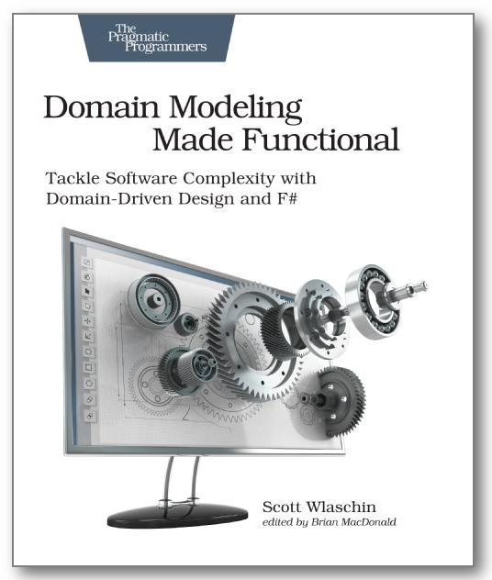
Some books

Slide 51

Clojure
Clojure, invented by Rich Hickey in 2007
Since you know F# it might be interesting to compare with Clojure
  Dynamically typed, immutable, data driven Lisp
https://clojure.org/
https://blog.cleancoder.com/uncle-bob/2019/08/22/WhyClojure.html

Slide 52

Haskell
Haskell, created in 1990
Purely functional
Statically typed
https://www.haskell.org/

Slide 53

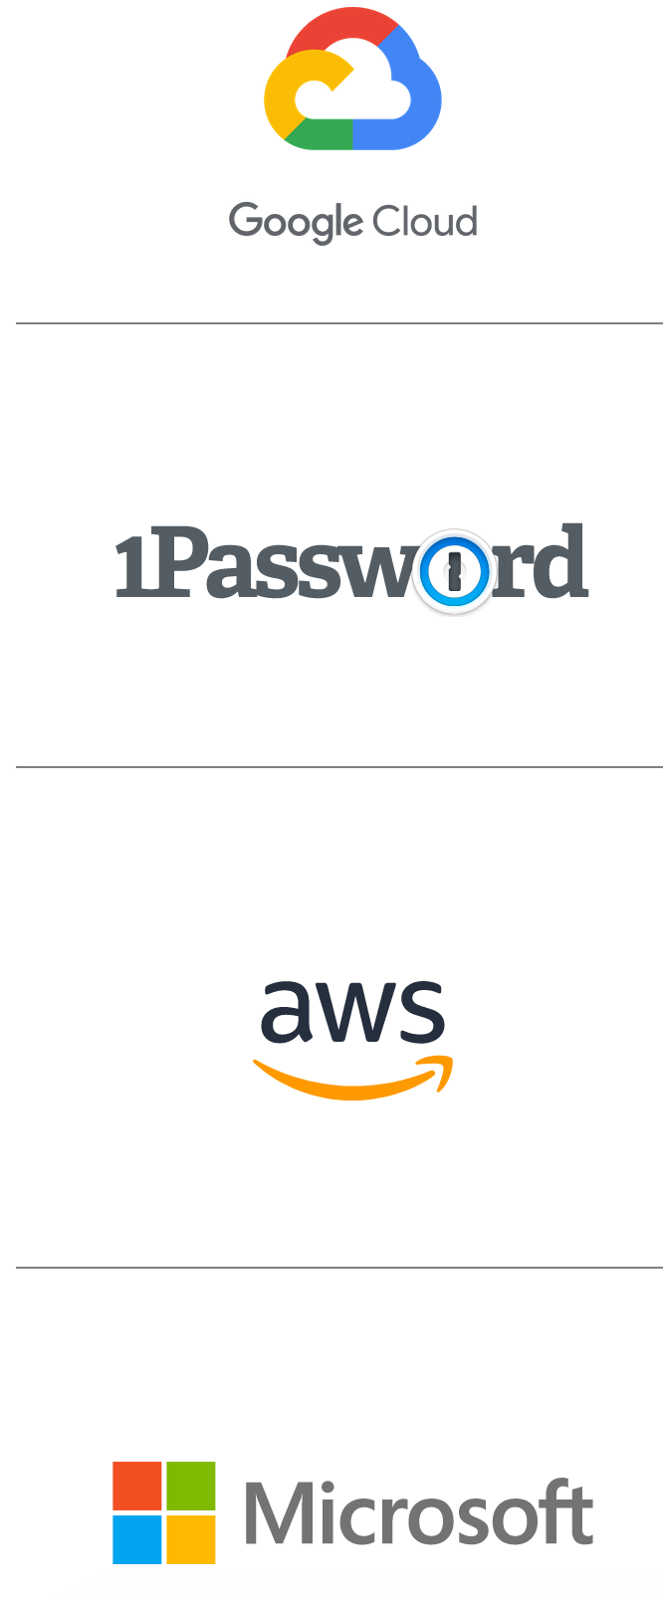

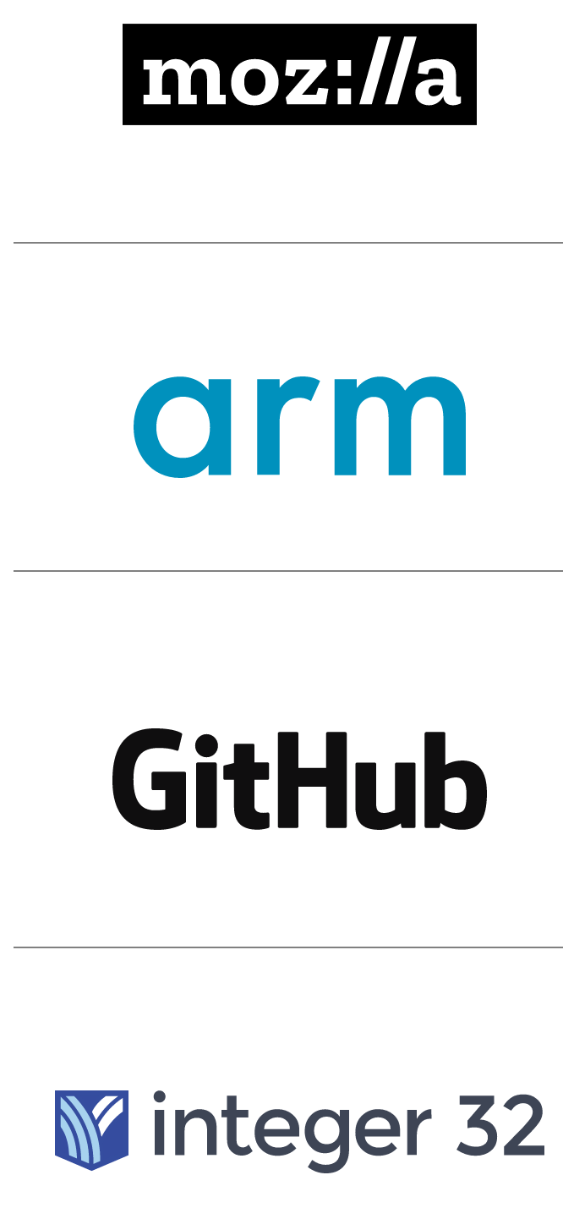
Rust – my highest hope for FP ideas becoming mainstream
Immutability by default
Higher order functions
Algebraic Data Types
Map/Filter/Fold
Lambdas
No OOP
Etc.
Strong corporate backing
”Close to the metal” - performance
https://www.rust-lang.org/

Slide 54
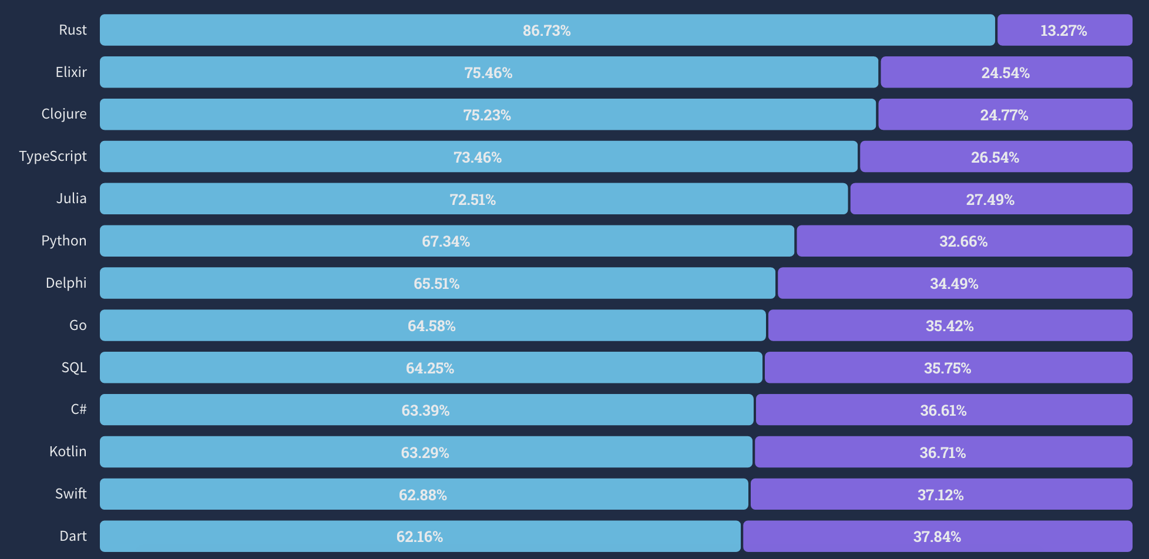
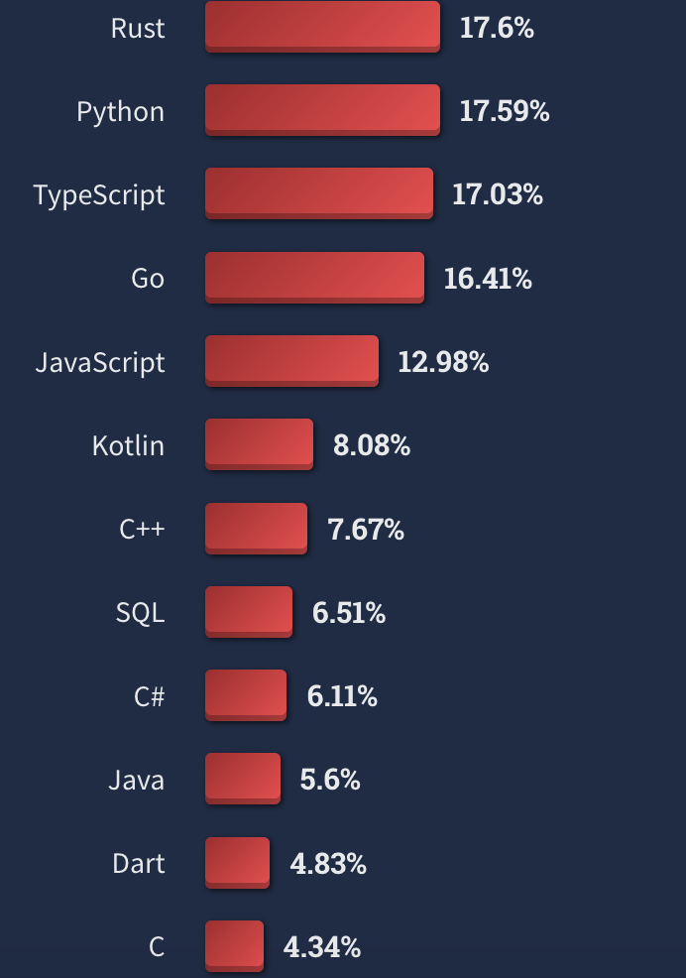
Rust is the most loved for the 7th year in a row – also wanted
Top 3 are FP languages
Most loved vs. dreaded
Want
https://survey.stackoverflow.co/2022/#most-loved-dreaded-and-wanted-language-love-dread

Slide 55
Functional Core – Imperative Edge – Never stop learning
The rest is details
stefan.l.karlsson@mdu.se
https://quality-developer.com/
https://github.com/zclj

